Slide 1
2021 Spirit Summit and
Rules Interpretation
Shawn Knight – NFHS Spirit Committee Chair
Shaunda Brown – NFHS Spirit Rules Interpreter
James Weaver - NFHS Director of Performing Arts and Sports

Slide 2

Thank you to our Spirit Partner Varsity

Slide 3
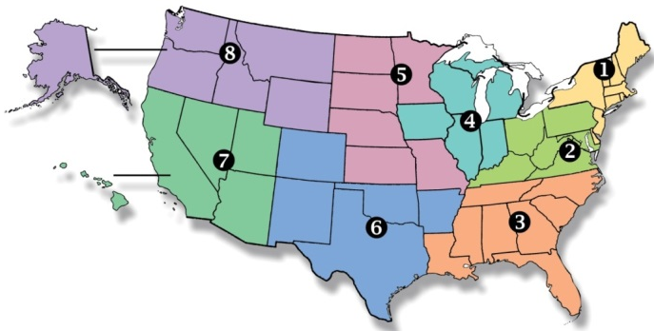
National Federation of
State High School Associations
NFHS (located in Indianapolis, IN – Est. 1920):
  National leader and advocate for
  high school athletics and
  performing arts programs.
  Serves 51 state associations, 19,500
  high schools and 12 million student
  participants.
  Writes playing rules for 17 high school
  sports for boys and girls.
  Offers online education courses for high school coaches,
  officials, parents, students and others.
  Ensures that students have opportunity to enjoy healthy participation, achievement and good sportsmanship in education-based athletics.

Slide 4
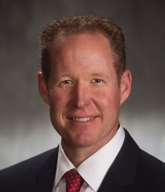
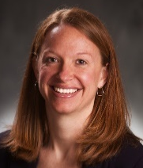
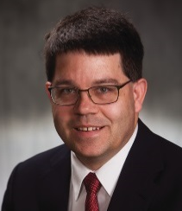
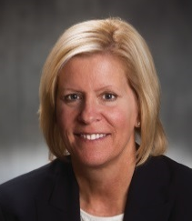
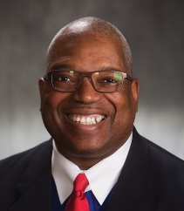
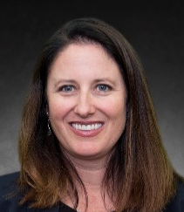
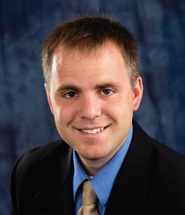
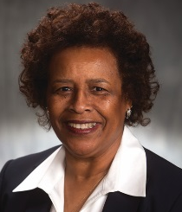
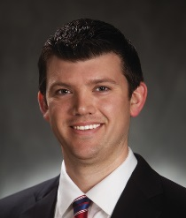
NFHS Rules Review Committee
The NFHS Rules Review Committee is chaired by the chief operating officer and composed of all rules editors. After each committee concludes its deliberations and has adopted its recommended changes for the subsequent year, such revisions will be evaluated by the Rules Review Committee.
Davis Whitfield
Chief Operating Officer
Lindsey Atkinson
Girls Lacrosse and Volleyball
Bob Colgate
Football and Sports
Medicine
Sandy Searcy
Softball, Swimming & Diving and Water Polo
Elliot Hopkins
Baseball and Wrestling
Julie Cochran
Cross Country, Gymnastics, Field Hockey and
Track & Field
James Weaver
Boys Lacrosse
and Spirit
Theresia Wynns
Basketball and Soccer
Dan Schuster
Ice Hockey

Slide 5

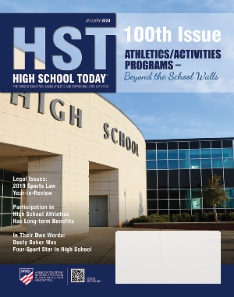
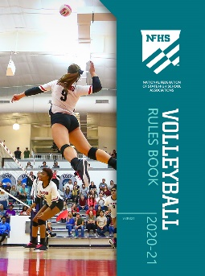

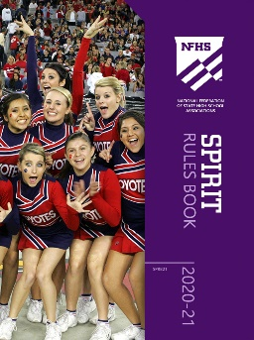
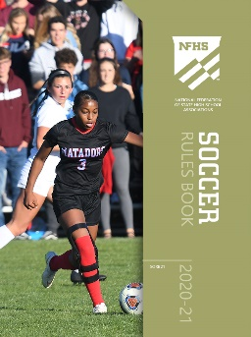

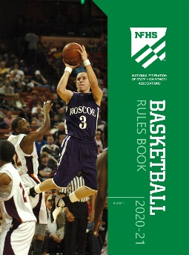

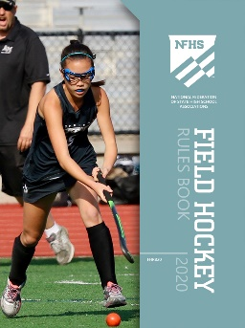
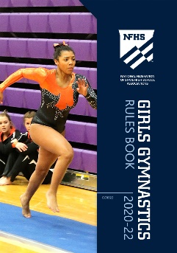
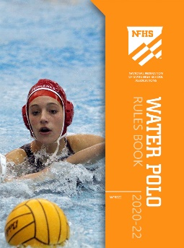

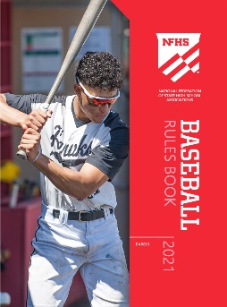
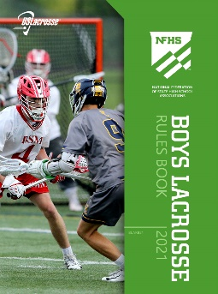
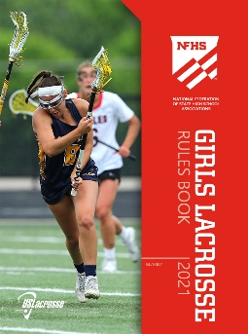
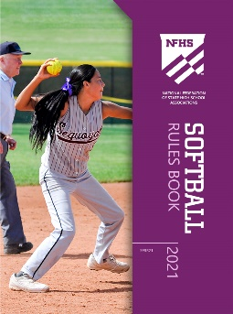

National Federation of
State High School Associations
The NFHS writes playing rules for 17 sports
for boys and girls at the high school level.
  Publishes 4 million pieces of materials annually.

Slide 6

NFHS Rules Book as e-Books
E-books features:
  Searchable
  Highlight areas of interest
  Make notes
  Easy navigation
  Adjustable viewing size
  Immediate availability

Slide 7

NEW NFHS Rules App
Rules App features:
  Searchable
  Highlight notes
  Bookmarks
  Quizzes for all sports
  Easy navigation
  Immediate availability
  Free to paid members of the NFHS Coaches
  and Officials Associations
  www.nfhs.org/erules for more information

Slide 8
2021 Rules Changes

Slide 9
Rule 2-1-21 Religious head coverings
Adjusted language to allow head coverings for religious reasons without state association approval.

Slide 10
3-2-1b 4-2-1b Stunting Personnel
A base must not:
a. Assume a back-bend, headstand, or handstand position
b. Hold objects in a hand that is supporting a top person.
Exception: A base and top person may share a pom during a dismount from a thigh stand, shoulder sit/straddle, shoulder stand, or prep.
Rationale: The exemption clarifies the current interpretation of rules 3-2-1 and 4-2-1.

Slide 11
3-3-3 Inversions
Delete sub-rule C.
c. The top person and at least one bracer maintains hand-to-hand/arm contact.
Rationale: Requiring hand-to-hand/arm contact may put the top person in a less than ideal position by having to force a connection with an arm instead of using the same technique they would if there were no bracer. This change would allow for common methods to be taught for common skills and lower the risk of injury.
Notes:
Comment-The criteria of how the top person should be caught is in the rule (3.3.6c) and not the definition.

Slide 12
Rule 3-3-6d Suspended Stunts (Deleted)
d. When the stunt begins in an inversion and transitions to a non-inverted position, the upper body contact may be released before the top person is no longer inverted.
Rationale: No longer needed after 2020 rule changes discontinued the requirement for upper body contact.

Slide 13
Rule 3-5-5c Release Stunts/tosses
c. The top person and at least one bracer maintain hand-to-hand/arm contact except for the following skills:
If the release is to a cradle position, the contact may be hand-to-foot and the bracer must be in a double-based prep with a spotter.
Rationale: Allows the hand-to-foot release to land back in a skill or other position besides a cradle. This will allow for a cleaner rule and interpretation without increasing the risk of injury.

Slide 14
Rule 4-2-8 Stunting Personnel
A spotter is required for tosses to single-base prep-level stunts in which the foot/feet of the top person is in the hands of the base and for tosses to single-base shoulder stands.
Rationale: Clarifies that a spotter is required anytime the feet of the top person are in the hands of a base or during the toss portion of a toss to shoulder stand. Mirrors the language in 3-2-8.
Notes:
Comment- This rule change allows the base of a non-extended stunt to hand or take a sign or prop to or from a top person with a hand that is not supporting a top person.

Slide 15
2021 Points of emphasis

Slide 16
Return to Play/activity
The NFHS continues to focus on the health and safety of all participants. Consideration should be taken into account whether at the beginning of the season or after an extended absence from the activity. This would include but not limited to mental, physical and emotional preparedness of the participant. Emphasis should be given to strength and conditioning, skill progressions, state association return to play protocols and any state and local guidelines. Further risk minimization would also include being mindful of the potential of overuse injuries due to extended practices, performances and competitions.

Slide 17
NFHS OFFICIALS Education

Slide 18

Notes:
OFFICIALS EDUCATION
Every opportunity should be taken to improve upon officiating. Clinics, course work, observations, video review, association meetings should all be considered when attempting to improve one’s skills in officiating. The NFHS has provided opportunities for officials and prospective officials to take courses and to review video to support learning and developing officiating skills.
Sport-Specific Officiating courses are offered in several sports. They are ideal for new officials and those in the first few years of officiating. These courses introduce officials to the mechanics and techniques used in the sport and provide specific information on an area within that sport. Individuals can complete a course within 30-45 minutes. The cost of these courses is $10.00 to NFHS Officials Association members and $20 for non-members.
“Interscholastic Officiating” is a general course on sports officiating and it is free to members and cost $20 for non-members. This course provides an introduction to skills and concepts used as an official. Several topics are covered such as: basics of becoming and staying an official, science of officiating, art of officiating, how to combine these skills for successful officiating.
Video clips are made available to NFHS Officials Association members. The video is clipped on specific topics and provides the rules references as well as dialogue on the topic.
The courses and videos are offered at www.NFHSLearn.com .
Courses Available:
Officiating Football
Officiating Volleyball – Ball Handling
Officiating Volleyball – Alignment
Officiating Basketball
Officiating Basketball – Three-Person Mechanics
Soccer – Fouls and Misconduct
Soccer - Offside
Swimming and Diving
Officiating Wrestling
Umpiring Softball
Future Courses to be Considered:
Umpiring Baseball
Field Hockey
Track and Field
Umpiring Softball – Mechanics
Communication Among Officials and Coaches

Slide 19
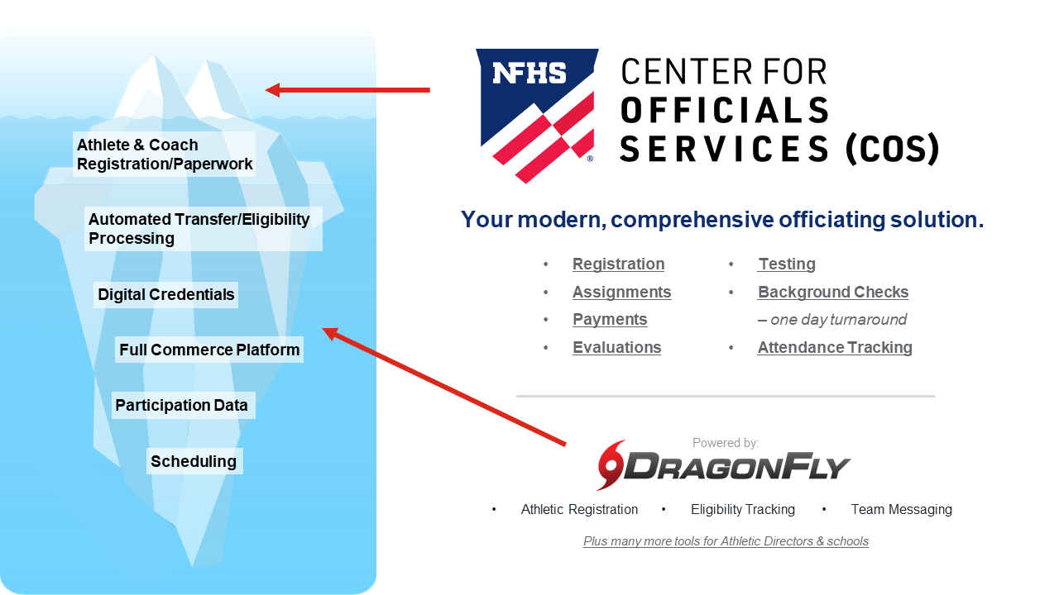
NFHS Center for Officials Services (COS)
Notes:
Your Complete Solution for Officials Management and More:
Registration
Assignment
Payment
Testing
Background Checks
For More Information on the NFHS – Center for Officials Services (COS) Contact:
Davis Whitfield, NFHS, dwhitfield@nfhs.org
Karissa Niehoff, NFHS, kniehoff@nfhs.org
Also If You’re Interested in Eligibility and Monitoring Requirements Contact
the Folks at Dragonfly:
Kirk Miller, Dragonfly, kirk@dragonflyathletics.com
Brandon Wallace, Dragonfly, brandon@dragonflyathletics.com

Slide 20
NFHS Learning Center

Slide 21

Notes:
The NFHS Learning Center, accessed at NFHSLearn.com has over 70 online professional development courses for the entire interscholastic community, including coaches, administrators, officials, parents, students, and individuals within performing arts programs. The mission and purpose of the NFHS Learning Center is focused on growing professional development opportunities. Those opportunities include courses, but now also incorporate additional videos such as “The Parent Seat” and “Beyond The Scoreboard,” which are short videos created to show to parents at Parent Meetings or show during events. The NFHS Learning Center has delivered over 10,000,000 courses and looks to continue to educate and be a valuable resource for the entire interscholastic community. Learn more at NFHSLearn.com!

Slide 22
NFHS Network

Slide 23


NFHS Network
By 2025, every high school sporting event in America will be streamed live.
The NFHS Network will be
THE DESTINATION for fans
to view these broadcasts.
27 Different Sports and Activities
www.NFHSnetwork.com
Notes:
The NFHS Network is the leader in streaming Live and On Demand high school sports.
Partnered with the National Federation of State High School Associations, 45 high school state athletic/activities associations, and PlayOn! Sports, the NFHS Network is a joint venture created to provide fans with the ability to stream high school sports on any device, from wherever they are.
All NFHS Network events are available to watch online at www.NFHSnetwork.com and through the NFHS Network Live App for iOS and Android. Follow us on Facebook, Twitter, Instagram, and YouTube.
Watching high school sports and events has never been easier.
The NFHS Network’s goal to broadcast live all 2 million high school sporting events by 2025.
The NFHS Network covers 27 different regular season and postseason sports, as well as other high school activities, celebrating the accomplishments of students-athletes, student broadcasters, and high schools across the country.

Slide 24
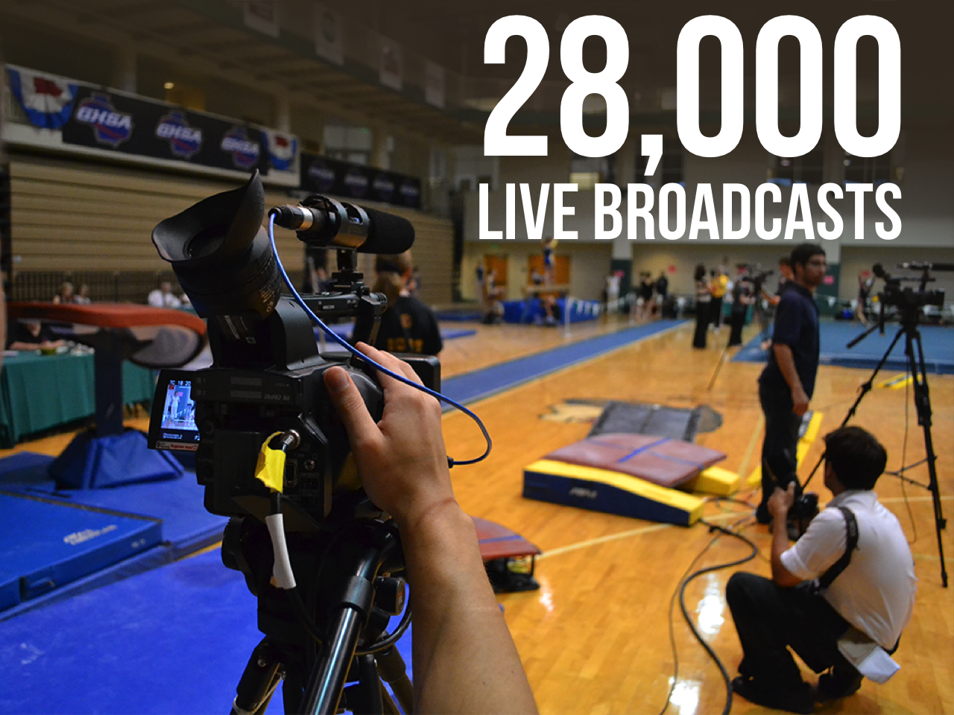
Notes:
The NFHS Network will broadcast over 150,000 live events this year. If your school is not a member of the NFHS Network School Broadcast Program, please contact us at Mark.Koski@NFHSnetwork.com

Slide 25
2021 Spirit discussion forum

Slide 26
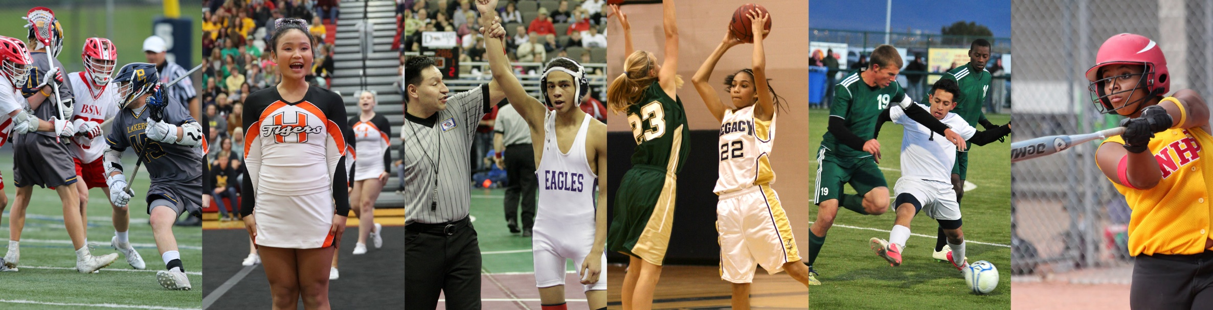
Thank You
National Federation of State High School Associations
PO Box 690 | Indianapolis, IN 46206
Phone: 317-972-6900 | Fax: 317.822.5700
www.nfhs.org | www.nfhslearn.com | www.nfhsnetwork.com

