Slide 1
2022 NFHS Rules Interpretation
Shawn Knight – NFHS Spirit Committee Chair
Shaunda Brown – NFHS Spirit Rules Interpreter

Slide 2

Thank you to our Spirit Partner Varsity

Slide 3
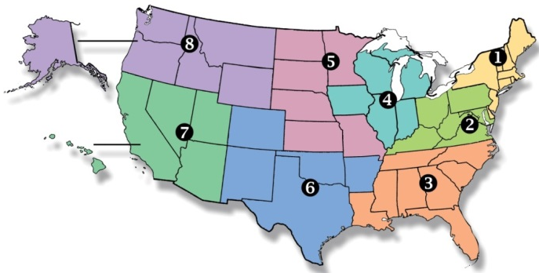
National Federation of
State High School Associations
NFHS (located in Indianapolis, IN – Est. 1920):
  National leader and advocate for
  high school athletics and
  performing arts programs.
  Serves 51 state associations, 19,500
  high schools and 12 million student
  participants.
  Writes playing rules for 17 high school
  sports for boys and girls.
  Offers online education courses for high school coaches,
  officials, parents, students and others.
  Ensures that students have opportunity to enjoy healthy participation, achievement and good sportsmanship in education-based athletics.

Slide 4
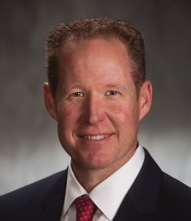


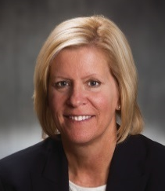
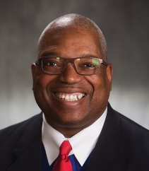
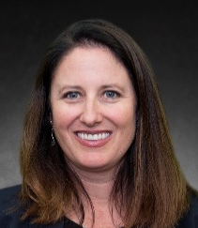

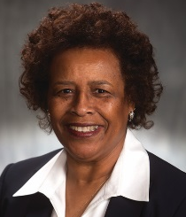
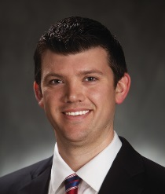
NFHS Rules Review Committee
The NFHS Rules Review Committee is chaired by the chief operating officer and composed of all rules editors. After each committee concludes its deliberations and has adopted its recommended changes for the subsequent year, such revisions will be evaluated by the Rules Review Committee.
Davis Whitfield
Chief Operating Officer
Lindsey Atkinson
Girls Lacrosse and Volleyball
Bob Colgate
Football and Sports
Medicine
Sandy Searcy
Softball, Swimming & Diving and Water Polo
Elliot Hopkins
Baseball and Wrestling
Julie Cochran
Cross Country, Gymnastics, Field Hockey and
Track & Field
James Weaver
Boys Lacrosse
and Spirit
Theresia Wynns
Basketball and Soccer
Dan Schuster
Ice Hockey

Slide 5


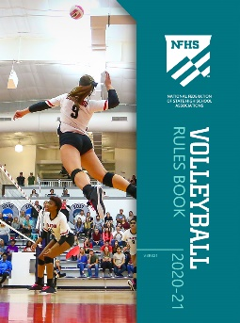
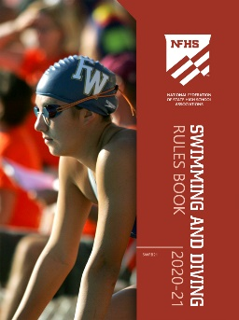
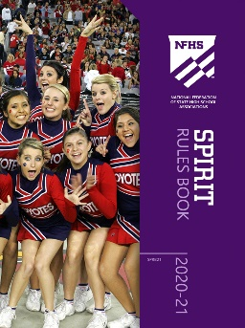
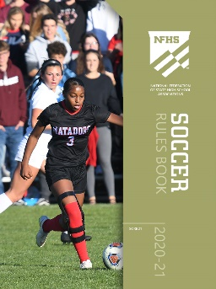

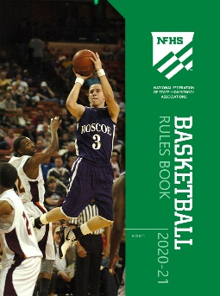


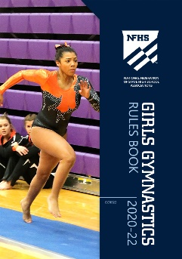



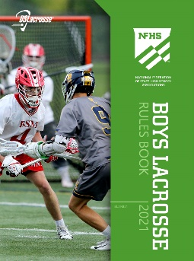
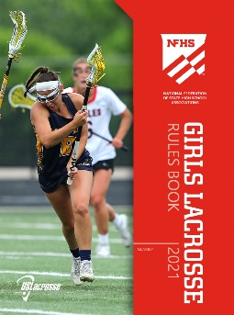
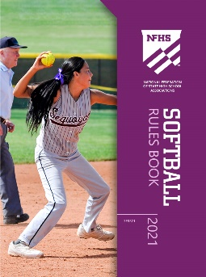

National Federation of
State High School Associations
The NFHS writes playing rules for 17 sports
for boys and girls at the high school level.
  Publishes 4 million pieces of materials annually.

Slide 6

NFHS Rules App
Rules App features:
  Searchable
  Highlight notes
  Bookmarks
  Quizzes for all sports
  Easy navigation
  Immediate availability
  Free to paid members of the NFHS Coaches
  and Officials Associations
  www.nfhs.org/erules for more information

Slide 7
2022 Rules Changes

Slide 8
Rule 1 Definitions
Airborne - A type of skill performed state in which a person is free of contact with from a person or the performing surface.
Headspring - A tumbling skill in which a person places both hands and his or her head on the performing surface, pushes off with the hands while flipping the legs overhead and landing on his or her feet. It is non-airborne in approach but airborne in descent following the inversion.
Rationale:
  The definition of airborne was revised to clarify the body position.
  The definition of headspring was revised to clarify the point in which the person becomes airborne.
Notes:
Rationale:
The definition of airborne was revised to clarify the body position.
The definition of headspring was revised to clarify the point in which the person becomes airborne.

Slide 9
Rule 2-1-11 General Risk Management
Soft, nonabrasive, and/or non-hardening supports, braces, soft casts, etc., that are unaltered from the manufacturer's original design/production do not require any additional padding. Supports/braces that have been altered from the manufacturer's original design/production Hard and unyielding items (guards, casts, braces, etc.) on the hand, wrist, forearm, elbow, or upper arm must be padded with a closed-cell, slow-recovery foam padding no less than one-half-inch thick if the participant is involved in partner stunts, pyramids or tosses. A participant wearing a lower body plaster cast or a walking boot must not be involved in partner stunts, pyramids, tosses, jumps or tumbling.
Rationale – Clarifies the padding requirements of hard and soft support devices and braces.
Notes:
Rationale – Clarifies the padding requirements of hard and soft support devices and braces.

Slide 10
3-2-1 4-2-1 Stunting Personnel
A base must not:
a. Assume a back-bend, headstand, or handstand position
b. Hold objects in a hand that is supporting a top person.
Exception: A base and top person may share a pom during a mount or dismount from a thigh stand, shoulder sit/straddle, shoulder stand, or prep.
Rationale: Allows an exception for poms in cheer and dance to be shared while building a stunt at prep level or below.
Notes:
Rationale: Allows an exception for poms in cheer and dance to be shared while building a stunt at prep level or below.

Slide 11
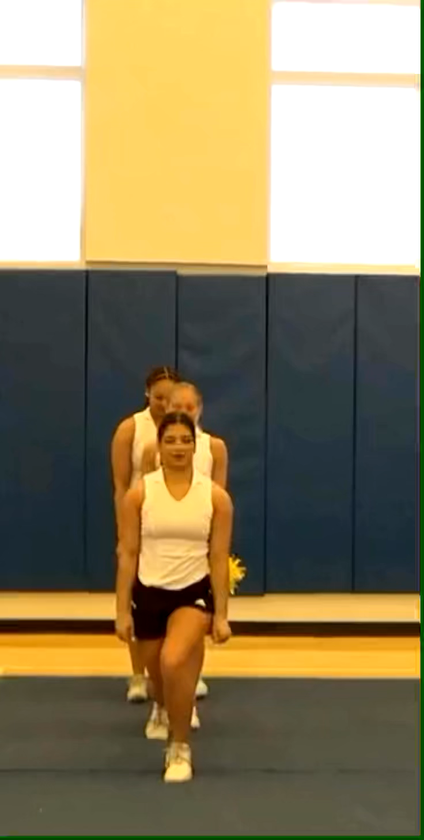
3-2-1 4-2-1

Slide 12
3-3-5a Inversions
Replaced the with: The top person and at least one bracer(s) must have a hand to hand/arm connection. This connection can be with one or both hands/arms.
Rationale: Allows the connection between a bracer and the top person(s) to be with one or both hands/arms during a braced flip.
Notes:
Rationale: Allows the connection between a bracer and the top person(s) to be with one or both hands/arms during a braced flip.

Slide 13
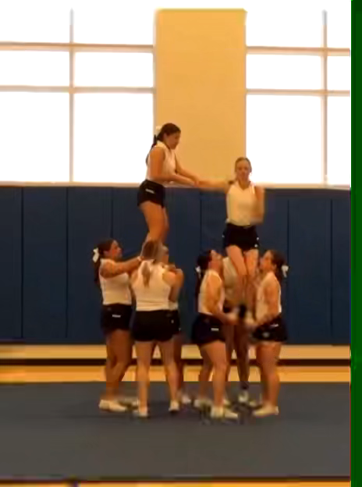
3.3.5.a

Slide 14
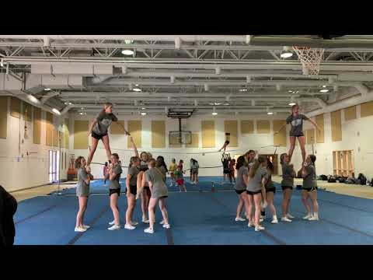
Illegal 3.3.5a

Slide 15
3-3-5D Inversions
d. Bracer(s) must be in a multi-based prep with a spotter and remain stationary.
Rationale: Requires the bracer to remain stationary during a flip inversion and aligns with the braced release skills.
Notes:
Rationale: Requires the bracer to remain stationary during a flip inversion and aligns with the braced release skills.
The bases of braced flip bracers must remain stationary, other than turning with the top person during movement around the bracer.

Slide 16
Rule 3-5-4 Release Stunts/tosses
A switch up toss caught in a vertical stunt by the original bases is permitted as an exception to Rules 3-5-2 and 3-5-3. Toss must not go significantly higher than extended position. A ball up position would not be considered against the significantly higher measurement.
Rationale: Permits a toss to be caught in any vertical stunt by the original bases. The toss cannot be significantly higher than the intended stunt.
Notes:
Rationale: Permits a toss to be caught in any vertical stunt by the original bases. The toss cannot be significantly higher than the intended stunt.
A toss technique can now be used to load to upright stunts as long as the top does not go significantly higher than the intended skill. Note that the “significantly higher” is in reference to where contact is made between the top and bases. Toss releases to a stunt are allowed from a ball-up and/or straight leg body positions only. A ball-up is the only allowed variation besides keeping the legs straight when tossing to a stunt.

Slide 17
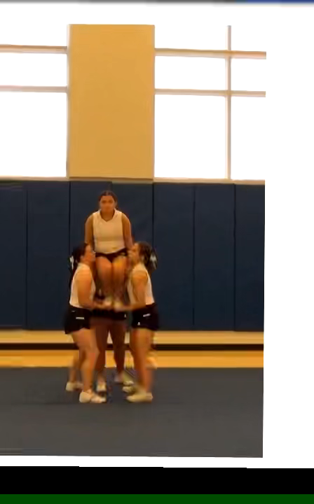
3-5-4

Slide 18
Rule 3-5-5c Release Stunts/tosses
A non-braced top person in a cradle position or horizontal position at prep level or below may be released to the original bases in a loading position or stunt at any level with no more than a ¼ turn.
Rationale: Permits a non-braced top person in a cradle position or horizontal position at prep level or below to be released to any stunt and caught by the original bases with no more than a 1¼ twist.
Notes:
Rationale: Permits a non-braced top person in a cradle position or horizontal position at prep level or below to be released to any stunt and caught by the original bases with no more than a 1¼ twist.

Slide 19
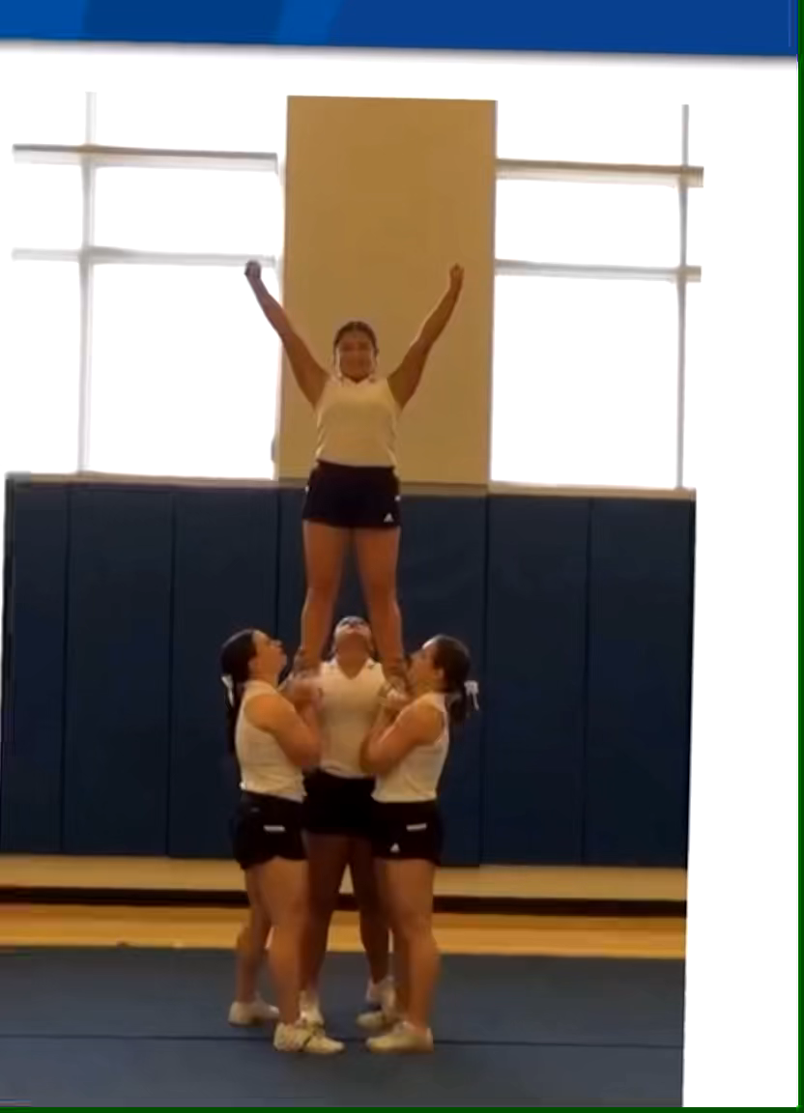
3-5-5c2

Slide 20
2022 Points of emphasis

Slide 21
Situations and Rulings
The situations and rulings contained in the NFHS Spirit Rules Book are intended to supplement and provide clarity of the rules. The rules will always take precedence over situations.

Slide 22
Sportsmanship
Spirit participants should strive to boost school spirit; promote good sportsmanship; develop good, positive crowd involvement; and help student participants and spectators achieve the most worthwhile educational objectives of the interscholastic program. Spirit leaders can effectively neutralize negative environments at any interscholastic contests.

Slide 23
Return to Play/Activity
The NFHS continues to focus on the health and safety of all participants. Consideration should be taken into account whether at the beginning of the season or after an extended absence from the activity. This would include but not limited to mental, physical and emotional preparedness of the participant. Emphasis should be given to strength and conditioning, skill progressions, state association return-to-play protocols and any state and local guidelines. Further risk minimization would also include being mindful of the potential of overuse injuries due to extended practices, performances and competitions.

Slide 24
Hair
The NFHS aims to be inclusive of all students from varying cultural backgrounds. Some spirit rules have been modified to allow for broader cultural expression through hairstyles. To continue risk minimization, length of hair and hair style must be appropriate for the activity and considered when adding embellishments.

Slide 25
Performing Surfaces
Performing surfaces and areas must be suitable for spirit activities. When utilizing mats during practices and games, consideration should be given to the total area necessary for the performance. Extra attention should be given to the difference in the performing surfaces if transitioning on and off the mat.

Slide 26
NFHS OFFICIALS Education

Slide 27

Notes:
OFFICIALS EDUCATION
Every opportunity should be taken to improve upon officiating. Clinics, course work, observations, video review, association meetings should all be considered when attempting to improve one’s skills in officiating. The NFHS has provided opportunities for officials and prospective officials to take courses and to review video to support learning and developing officiating skills.
Sport-Specific Officiating courses are offered in several sports. They are ideal for new officials and those in the first few years of officiating. These courses introduce officials to the mechanics and techniques used in the sport and provide specific information on an area within that sport. Individuals can complete a course within 30-45 minutes. The cost of these courses is $10.00 to NFHS Officials Association members and $20 for non-members.
“Interscholastic Officiating” is a general course on sports officiating and it is free to members and cost $20 for non-members. This course provides an introduction to skills and concepts used as an official. Several topics are covered such as: basics of becoming and staying an official, science of officiating, art of officiating, how to combine these skills for successful officiating.
Video clips are made available to NFHS Officials Association members. The video is clipped on specific topics and provides the rules references as well as dialogue on the topic.
The courses and videos are offered at www.NFHSLearn.com .
Courses Available:
Officiating Football
Officiating Volleyball – Ball Handling
Officiating Volleyball – Alignment
Officiating Basketball
Officiating Basketball – Three-Person Mechanics
Soccer – Fouls and Misconduct
Soccer - Offside
Swimming and Diving
Officiating Wrestling
Umpiring Softball
Future Courses to be Considered:
Umpiring Baseball
Field Hockey
Track and Field
Umpiring Softball – Mechanics
Communication Among Officials and Coaches

Slide 28
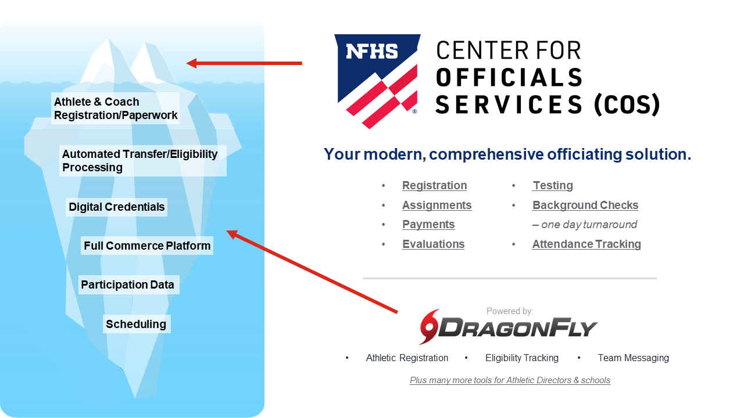
NFHS Center for Officials Services (COS)
Notes:
Your Complete Solution for Officials Management and More:
Registration
Assignment
Payment
Testing
Background Checks
For More Information on the NFHS – Center for Officials Services (COS) Contact:
Davis Whitfield, NFHS, dwhitfield@nfhs.org
Karissa Niehoff, NFHS, kniehoff@nfhs.org
Also If You’re Interested in Eligibility and Monitoring Requirements Contact
the Folks at Dragonfly:
Kirk Miller, Dragonfly, kirk@dragonflyathletics.com
Brandon Wallace, Dragonfly, brandon@dragonflyathletics.com

Slide 29
NFHS Learning Center

Slide 30

Notes:
The NFHS Learning Center is the home to more than 90 online professional development courses for everyone within the interscholastic community - coaches, students, officials, parents, administrators, and individuals within performing arts programs. More than 60 courses are available for free.
The NFHS is an Accredited Institution and has delivered more than 15 million courses on its NFHS Learning Center platform since its inception in 2007. In receiving national accreditation by Cognia, the NFHS has upheld itself to rigorous standards that focus on productive learning environments, equitable resource allocation that meet the needs of learners, and effective leadership.
The NFHS Learning Center features its flagship coaching course, “Fundamentals of Coaching,” as well as several health and safety courses that have been completed by millions of individuals, such as “Concussion in Sports,” “Heat Illness Prevention,” “Sudden Cardiac Arrest” and “Protecting Students from Abuse.” The NFHS Learning Center offers several national credentials that can be earned by individuals who complete specific NFHS courses. Through the School Honor Roll Program, schools can earn a physical banner to hang in their school.
To learn more and start your professional development journey, please visit the NFHS Learning Center at NFHSLearn.com.

Slide 31
NFHS Network

Slide 32


NFHS Network
By 2025, every high school sporting event in America will be streamed live.
The NFHS Network will be
THE DESTINATION for fans
to view these broadcasts.
27 Different Sports and Activities
www.NFHSnetwork.com
Notes:
The NFHS Network is the leader in streaming Live and On Demand high school sports.
Partnered with the National Federation of State High School Associations, 45 high school state athletic/activities associations, and PlayOn! Sports, the NFHS Network is a joint venture created to provide fans with the ability to stream high school sports on any device, from wherever they are.
All NFHS Network events are available to watch online at www.NFHSnetwork.com and through the NFHS Network Live App for iOS and Android. Follow us on Facebook, Twitter, Instagram, and YouTube.
Watching high school sports and events has never been easier.
The NFHS Network’s goal to broadcast live all 2 million high school sporting events by 2025.
The NFHS Network covers 27 different regular season and postseason sports, as well as other high school activities, celebrating the accomplishments of students-athletes, student broadcasters, and high schools across the country.

Slide 33
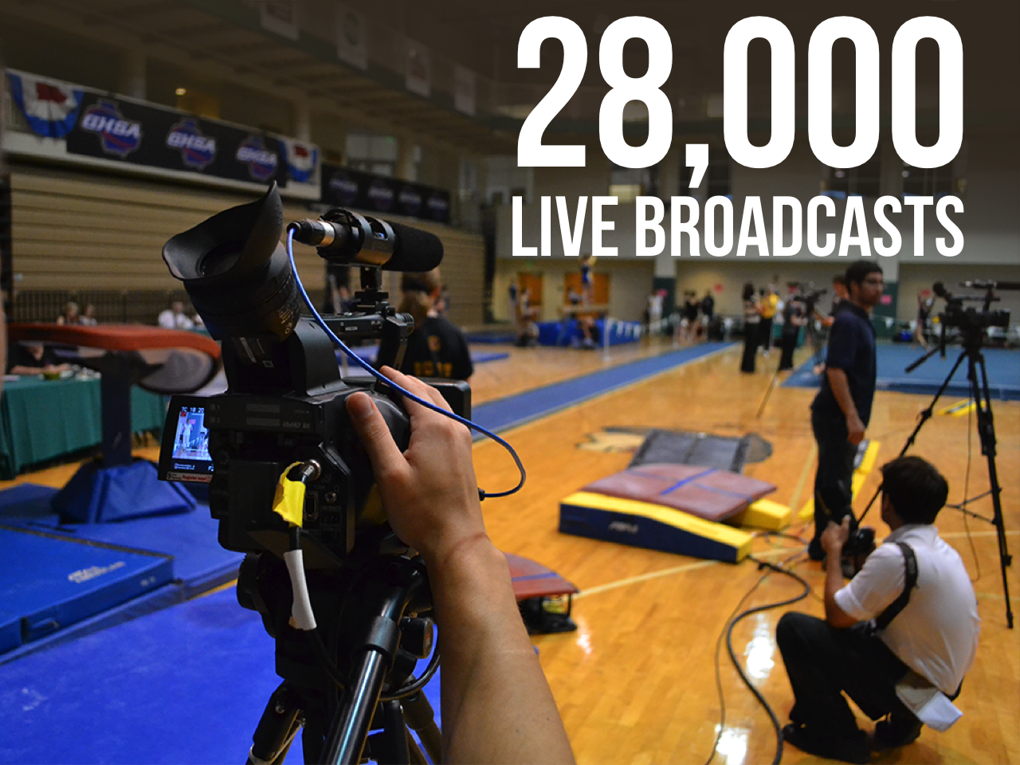
Notes:
The NFHS Network will broadcast over 150,000 live events this year. If your school is not a member of the NFHS Network School Broadcast Program, please contact us at Mark.Koski@NFHSnetwork.com

Slide 34
2022 Spirit discussion forum

Slide 35
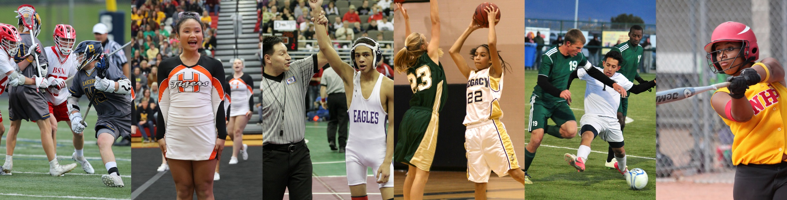
Thank You
National Federation of State High School Associations
PO Box 690 | Indianapolis, IN 46206
Phone: 317-972-6900 | Fax: 317.822.5700
www.nfhs.org | www.nfhslearn.com | www.nfhsnetwork.com

