Slide 1

Transform Sales with Gen AI
Microsoft 365 Copilot for Sales

Slide 2

Microsoft 365 Copilot for Sales
Implementation executive summary
1
Get ready
2
Onboard & engage
3
Deliver impact
4
Extend & optimize
Learn about Copilot for
Sales overview, review 10 skills and look at resource guide to get started.
Select sales teams for roll
out and follow the adoption playbook to see value fast
Review success measures with the Copilot for Sales Dashboard.
Extend to new scenarios.
Identify new high value scenarios
User
Enablement
Define key target personas
and scenarios
Track progress and iterate
Continue to train and
measure impact
Identify your success team
Review Microsoft resources
Build momentum with success stories and knowledge sharing
Deploy training and Champion programs, engagement community
Learn about the architecture and responsible AI practices.
Deploy and configure
app for Salesforce or Dynamics 365.
Familiarize with
usage dashboard.
Learn about
extensibility scenarios.
Technical Readiness
Address data security, governance, and data access questions
Review the Copilot for Sales Dashboard
Analyze user retention and engagement and collaborate with sales enablement leads
Understand your business needs
Build your own extensions
Review the deployment
guide, installation article
and troubleshooting materials
Leverage Tech community
for best practices and support
Build shared implementation
plan with User Enablement team
Microsoft is here to help accelerate your Copilot for Sales adoption

Slide 3
Reimagine the sales experience
Cut the
drudgery
Connect
the data
Empower sales organizations with AI
Crush
the sale
Continuously
improve
Notes:
This is where we see a huge opportunity for AI as a sales assistant and productivity booster.
AI is poised to reimagine the sales experience for the better by helping sellers:
Cut the drudgery of mundane tasks by automating and simplifying email management, taking meeting notes, and entering data so sellers can focus on building relationships.
AI can also surface the right information at the right time, in the flow of work, so sellers can answer customer questions immediately and build credibility with their customers.
AI keeps the momentum rolling so sellers can crush the sale with AI-powered recommendations and reminders when deals are going cold, deadlines are upcoming, and any account updates occur.
And lastly, AI helps sellers continuously improve by providing real-time analysis of customer interactions and coaching insights, so sellers know what works and what doesn’t.

Slide 4
The role of the seller is getting harder
Percent of surveyed sellers who say success expectations and the number
of supported customers and accounts have increased in the last year¹
Amount of time sellers spend on administrative and non-selling duties²
Researching prospects
Preparation and planning
79%
70%
Generating quotes/proposals
Manually entering sales data
Administrative tasks
Prioritizing leads/opportunities
Internal meetings/trainings
¹Microsoft. “Sellers’ attitudes about AI.” June 2023. An Ipsos study commissioned by Microsoft. Study included 700 participants who use professional
CRM systems at organizations of at least 300 people. Industries include Financial Services, Professional Services, Manufacturing, Retail, Technology, and Healthcare.
²Microsoft-sponsored Futurum Research 2022.
Notes:
With the explosion of information and digital selling, the last several years have had a profound impact on work for sellers. Customers are demanding more personalized interactions with their sellers than ever.
As a result, Sellers experience increased responsibilities and expectation for work, including greater expected success in sales, account interactions, more tools needed to complete the job, and more number of customers/accounts to support. In a Microsoft-conducted study, we found that 79% of sellers say the expectation of success has increased in the last year. Likewise, 79% of sellers also say that they support more customers and accounts now than they did one year ago.
According to research done by Futurum in 2022, Sales professionals only spend one-third of their time actually selling. They spend around 70% of their time on administrative and other non-selling duties. These can be tasks from researching prospects, organizing data in their CRM, manually updating sales data across different platforms, and figuring out how to prioritize leads and opportunities.
Lack of focus time negatively impacts sellers’ ability to enjoy their work, manage time efficiently, and develop sales strategies. We need a solution that frees sellers up from these mundane tasks so they can focus on what they excel at: engaging with buyers to understand their needs and motivations, strengthening their customer relationships, and closing the deal.

Slide 5
The AI advantage for sales
Leading consulting companies estimate that sales organizations
can benefit significantly from generative AI
Sales efficiency
Data quality + sales effectiveness
29%
+50%
jump in lead-to-sale
conversion rate⁴
of sales time can be automated¹
3-5%
3-15%
of revenue uplift for players
that invest in AI⁴
productivity lift²
(total sales expense)
99%
2X
of sellers would reinvest time
saved from AI on work tasks³
lift in cross-selling and up-selling rate⁴
¹Bain & Company. How Generative AI Will Supercharge Productivity. August 2023.
²McKinsey. The economic potential of generative AI: The next productivity frontier. June 2023.
³Microsoft. “Sellers’ attitudes about AI.” June 2023. An Ipsos study commissioned by Microsoft. Study included 700 participants
who use professional CRM systems at organizations of at least 300 people. Industries include Financial Services, Professional Services, Manufacturing, Retail, Technology, and Healthcare.
⁴McKinsey. AI-powered marketing and sales reach new heights with generative AI. May 2023.
Notes:
Leading consulting companies have looked into the potential impacts of AI, specifically to the sales role, and found significant results.
Bain and Company estimated that 29% of labor time for sales roles can be automated with generative AI. That’s huge time savings right out of the gate with Generative AI adoption, reducing those mundane tasks I talked about earlier.
Similarly, a McKinsey study found that implementing generative AI could increase sales productivity by approximately 3 to 5 percent of current global sales expenditures.
While it’s true that saved time is only helpful if it’s used productively, we surveyed 700 sellers across various organizations, and found that 99% of sellers surveyed said that if AI saved them an hour, they would reinvest that time on work tasks.
And maybe even more important than the impacts on sales efficiency and productivity are the long-term impacts on organization’s bottom line.
McKinsey found that organizations can see over a 50% increase in lead-to-sale conversion, cross-selling, and up-selling rates with the adoption of generative AI.
They are also seeing that players that invest in AI are seeing a revenue uplift of 3 to 15 percent and a sales ROI uplift of 10 to 20 percent.
At Microsoft, we know how important it is for you to equip your employees and sales teams with the tools and skills for success. The solution was clearly AI, and we’ve been focusing our efforts on creating a solution tailored specifically for seller needs. I’m excited today to share with you what we’ve developed.

Slide 6
Do more with less with Microsoft Copilot for Sales
Copilot for Sales can drive revenue-related goals, such as growing customer acquisition, increasing upsell/cross-sell, and improving customer retention and operational efficiency.
Increase revenue
Decrease costs
Customer acquisition
Upsell / cross-sell
Customer retention
Operational efficiency
0.5%
3.1%
1.0%
2.4%
up to
up to
up to
up to
increase in number
of leads generated
increase in
upsell / cross-sell rate
of revenue lift from higher renewal rate / retention
of at-risk customers
capture of
productive manager
and assistant time
Source: Percentage improvements were calculated based on a sample set of Copilot for Sales customer deployments, third-party analyst reports from Boston Consulting Group, Bain & Company, and McKinsey, and Microsoft’s internal business value management database. Findings resulted in the following statistical ranges: customer acquisition (0.4-0.5%), upsell/co-sell (2.5-3.1%), customer retention (0.8-1.0%), and operational efficiency (1.8-2.4%).
Notes:
Adopting new technology is a daunting task, and I know how important it is for you to evaluate the long-term impacts on the bottom line before committing. We’ve looked extensively into the potential business impacts of adopting Copilot for Sales, pulling together data from early customers, Microsoft’s own deployment, and research done by third-party analysts.
We found that Copilot for Sales can drive revenue-related goals in four major areas of business: customer acquisition, increasing upsell and cross-sell, improving customer retention, and improving operational efficiency. It can do this by:
Saving time for sellers so they can manage more leads
Provide better meeting prep, cross-company insights, and in-call guidance in the flow of work so they can drive upsell and cross-sell
Keep up with and retain customers with account summaries and actionable insights
And save sales assistant and manager time with seamless CRM updates and account analysis
We’re looking at up to a 0.5% increase in number of leads, 3.1% increase in upsell and cross-sell rates, 1% revenue lift from higher renewal and retention rates, and 2.4% capture of productive manager and sales assistant time.

Slide 7
Early evidence of Microsoft Copilot for Sales success
30
mins
saved per customer meeting and per email using meeting summary¹ and email generation² features
  Implementing Microsoft
  Copilot for Sales has saved
  time, improved skills, contributed to better work-life balance, and increased revenue by 25% in one quarter.”¹
83%
of sellers say Copilot for Sales
makes them more productive³
79%
of sellers indicate Copilot
for Sales reduces admin work³
David Swenson,
Business Development Director at Netlogic
78%
of sellers say Copilot for Sales
helps them stay in the flow of work³
¹Microsoft. How Netlogic Computer Consulting is Boosting its Sales Performance with Microsoft Copilot for Sales. May 31, 2023.
²Microsoft. Avanade puts people first, accelerates sales productivity with Copilot in Microsoft Dynamics 365 Sales. Nov. 23, 2023.
³Microsoft. What Can Copilot’s Earliest Users Teach Us About Generative AI at Work? Nov. 15, 2023.
Notes:
Speaking of increased sales efficiency, sales reps at our early customer organizations reported saving up to 30 minutes per customer meeting and 30 minutes per email by using Copilot for Sales meeting summary and email generation capabilities. We surveyed Microsoft sellers to get a better idea of how Copilot for Sales is affecting their experiences personally, and 83% of surveyed sellers said that they are more productive with Copilot for Sales, 79% indicate that Copilot for Sales reduces admin work, and 78% of sellers say it helps them stay in the flow of work.
And I love this quote from David Swenson, the business development director at our customer organization, Netlogic. David said that implementing Copilot for Sales has helped his teams save time, improve skills, contribute to better work-life balance, and increase revenue for the company by 25% in one quarter from this higher level of efficiency.
These testimonials are from customers who were previewing a subset of early Copilot for Sales capabilities. As we continue to improve and expand the product, we expect to see even more dramatic impact metrics.

Slide 8
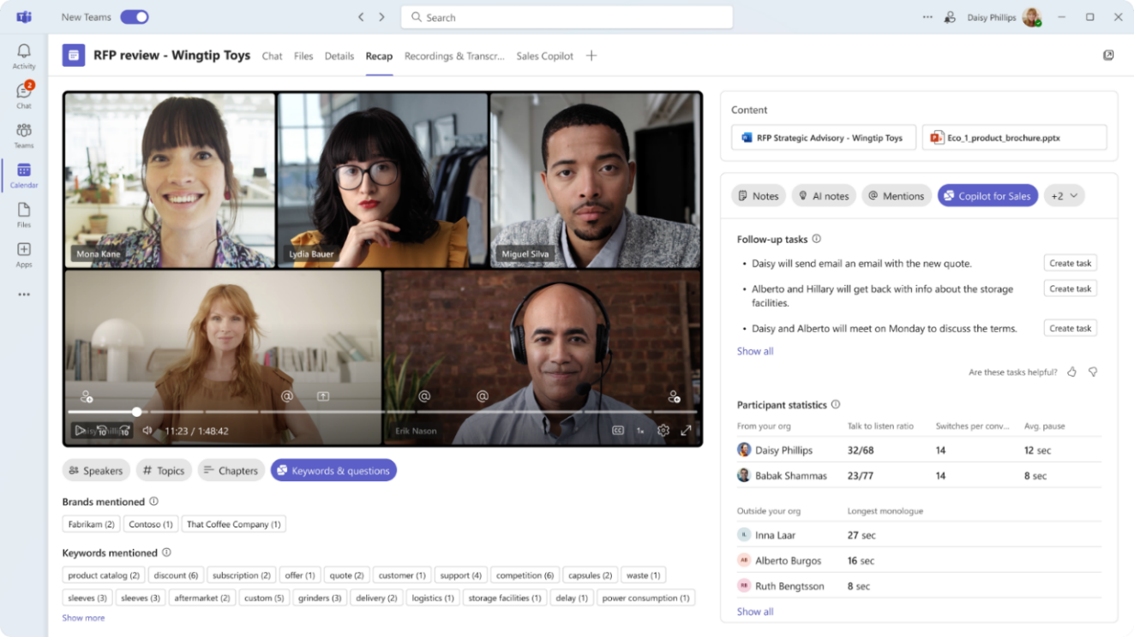






Microsoft Copilot for Sales
Next-generation AI assists sales teams with tedious tasks like catching up on pipeline, updating CRM data, preparing for meetings, and analyzing calls so they can focus on closing the deal.
View opportunity summary
Create CRM tasks from a meeting
Analyze sales conversations
Update opportunity stage
Draft a proposal
Show conversion rate
Create a revenue data chart
Create a pitch presentation
Copilot for Sales is experienced in Microsoft 365 and connects to your CRM system
Notes:
So let’s dive into Microsoft Copilot for Sales some more. Microsoft Copilot for Sales is an AI assistant designed for sales teams to maximize productivity and close more deals. It brings sales insights, recommendations, and next-generation AI into the tools that sellers use daily like Microsoft Outlook, Teams, and Word. This cuts down on tedious tasks for sellers like switching between their collaboration and productivity apps and their CRM system to update the right information, and searching manually for the right information to answer a question or create a document. Together, sellers can harness the benefits of generative AI across all workflows and productivity surfaces seamlessly.
ALT (for customer familiar with Sales Copilot)
Microsoft Copilot for Sales is the next evolution of Microsoft Sales Copilot, bringing the power of Microsoft Copilot for M365, Microsoft Copilot Studio, and seller specific CRM information in the flow of work. Copilot for Sales works with any CRM, helps sellers save time and energy, generate innovative ideas, build stronger customer relationships, and ultimately close more deals.
Copilot for Sales costs $50 user/month is inclusive of the Copilot for Microsoft 365 subscription. Customers who already have Copilot for Microsoft 365 will be able to purchase Copilot for Sales as a $20 step- up.
And now, I want to play a short video showing just some of the great things Microsoft Copilot for Sales can do.

Slide 9









Microsoft Copilot for Sales
Animated slide: This slide contains automated animation (shown in Slide Show mode)
Your Gen AI
assistant at work
for sales teams
Natural Language
Large Language Models (LLMs)
Web
grounding
Microsoft Graph grounding
Enterprise-grade data protection
CRM platform
Salesforce Sales Cloud
Microsoft Dynamics 365 Sales
Sales insights, content, and
recommendations
Commercial data protection
The
Internet
Microsoft 365 Apps
Copilot
Studio
Notes:
Copilot for Sales builds on Large language models and next-generation AI from Copilot for Microsoft 365, enhancing it with connectivity to your CRM platforms like Microsoft Dynamics 365 Sales and Salesforce Sales Cloud to bring sales-specific insights and recommendations to apps like Microsoft Outlook, Microsoft Teams, Microsoft Word, and more.

Slide 10
Enhance Copilot for Microsoft 365 with capabilities for specific teams (1 of 2)
Microsoft Copilot for Sales
Copilot for Microsoft 365
Users that benefit most | Sellers, Sales Managers, Sales Operations | Information Workers
Out-of-the-box integrations | Salesforce Sales Cloud Microsoft Dynamics 365 Sales
Sample use-cases | Draft email replies using CRM data and insights | Draft email replies
 | Summarize emails with customer context from CRM and see sales-specific suggested actions | Summarize emails to catch up quickly
 | Draft a document (e.g., sales brief) using CRM records as source | Draft a document from multiple source files
 | In meetings, get real-time sales tips and opportunity summary from CRM | In meetings, get answers on meeting discussions
 | Summarize meeting; Add action items as tasks in CRM directly from Teams, analyze sales keywords | Summarize meeting with action items
Email Read | Save Emails and Appointments to CRM
 | Summarize Email Threads with linked CRM data and BANT analysis
 | Auto Update Contact Info To CRM
 | Read / Write / Summarize access to related CRM entities

Slide 11
Enhance Copilot for Microsoft 365 with capabilities for specific teams (2 of 2)
Microsoft Copilot for Sales
Copilot for Microsoft 365
Email Compose | Draft Reply With CRM Data
 | Draft Reply with Teams Meeting Summary and Tasks
 | Set Up Teams Channels From Outlook (Collab Spaces / Deal Rooms)
 | Read / Write / Summarize access to related CRM entities
Calendar | Meeting Prep w/ CRM Opportunity Summary
 | Read / Write / Summarize access to related CRM entities
During Meeting | Real-time sales tips (Competitor/Brand mentions)
 | Read / Write / Summarize access to related CRM entities
Post Meeting | Sentiments, Talking Speed, Talk To Listen Ratio for seller self-improvement
 | Create CRM Tasks from Follow-ups
Team/Channel | Collaborate using Collab Spaces – Account and Deal Room sales templates
Message Extension | Search and share CRM entities as adaptive cards across Outlook and Teams

Slide 12

Investec
Customer:
  Investec
Industry:
  Banking and Capital Markets
  Country:
  United Kingdom
Products and services:
  Dynamics 365
  Dynamics 365 Customer
  Insights - Journeys
  Dynamics 365 Customer Service
  Dynamics 365 Sales
  Microsoft Copilot for Sales
  Microsoft Teams
  Outlook
Read full story here
“We’re estimating that we’re making approximately 200 hours of savings a year across the bank. That’s a huge amount of time that we can transfer from doing mundane tasks to energy directed straight back to clients.”
— Daniel Speirits: Sales and Marketing Product Manager at Investec
Situation:
Solution:
Impact:
International banking firm Investec faced challenges in efficiently managing customer relationships and sales processes. They needed
a solution to enhance customer engagement and streamline sales operations. The goal: deliver white glove service at scale.
An early adopter, Investec implemented Copilot for Sales, leveraging its AI-driven insights and automation capabilities. Copilot helped the sales teams prioritize leads, personalize interactions, and gain richer, real-time insights into customer data.
The adoption of Copilot for Sales led to significant improvements in sales performance. Investec experienced enhanced customer satisfaction, increased sales productivity, and a more cohesive sales strategy that continues to drive business growth.
Notes:
Microsoft Customer Story-Lumen’s strategic leap: How Copilot is redefining productivity and employee engagement
https://customers.microsoft.com/en-us/story/1771760434465986810-lumen-microsoft-copilot-telecommunications-en-united-states

Slide 13

Lumen Technologies
“It typically takes a seller four hours to do research for customer outreach, and with generative AI, they can now do that in 15 minutes. Four hours back each week is worth
$50 million in revenue over a 12-month period.”
Customer:
  Lumen
Industry:
  Telecommunications
  Country:
  United States
Products and services:
  Microsoft Copilot
  Microsoft Copilot for M365
  Microsoft Copilot for Sales
  Microsoft Teams
Read full story here
— Ashley Haynes-Gaspar: Chief Revenue Officer at Lumen Technologies
Situation:
Solution:
Impact:
Lumen Technologies, a global leader in communications, was transitioning from traditional telecom to a tech-driven, innovative, and efficient enterprise. They needed a solution to enhance productivity and customer service.
Change can be challenging, and Lumen knew they needed the best tools. So, they adopted Copilot for Sales for several thousand employees. It automated routine tasks, increasing efficiency and empowering the workforce as the enterprise evolved.
Making strategic use of Copilot for Sales has significantly improved employees’ work-life balance and enhanced customer satisfaction. By streamlining operations, Lumen has maintained a competitive edge and positioned itself as a leader in the digital age.
Notes:
Microsoft Customer Story-Lumen’s strategic leap: How Copilot is redefining productivity and employee engagement
https://customers.microsoft.com/en-us/story/1771760434465986810-lumen-microsoft-copilot-telecommunications-en-united-states

Slide 14


Top 10 to try first with Microsoft 365 Copilot for Sales
Foundational skills for new users
1
2
3
4
5
Save customer emails and meetings easily
Capture a new customer contact or a lead from email
View opportunity summary in Outlook
Create or edit an opportunity or Account from Outlook
Get ready for customer meetings with a summary card
Show consistent customer engagement by capturing emails and meetings in CRM automatically.
Create new contacts or leads directly from your Outlook inbox so that you can keep track of your stakeholders.
View opportunity summary, and relevant insights (Budget, Authority, Need, Timing) in Outlook
Create new accounts and opportunities without switching to your CRM.
Prepare for a customer meeting thoroughly and quickly with an AI generated summary leveraging data in CRM and M365.
6
7
8
9
10
Follow up with an email after a customer meeting
Update CRM after customer meetings
Summarize an
email thread with sales data from CRM
Draft an email reply with sales information
Share CRM data in Outlook and Teams
Follow up on next steps and action items immediately after a meeting with AI generated draft.
Capture CRM tasks directly from AI generated summary when recording a Teams meeting
Get quickly caught up on a long email thread with customers
Generate customer replies using sales prompts, data, and insights. Personalize email by adjusting tone and length.
Share sales data from CRM such as contacts, accounts, opportunities without switching application.
For more scenarios, visit: aka.ms/CopilotForSalesAdoption

Slide 15

Microsoft Copilot for Sales Resources Guide
Introduction
Install & try
Onboard & Adopt
Microsoft Copilot for Sales Website
Copilot for Sales blogs
Microsoft Copilot for Sales FAQ
Deployment guide for Salesforce
Deployment guide for Dynamics
Access Copilot for Sales app
Use Copilot for Sales in Outlook
Use Copilot for Sales in Teams
Troubleshoot
Adoption Website
Train the Trainer deck
Get support
Deep-dive
Configure
Copilot for Sales functional overview
Architecture Overview
Responsible AI Overview
Supported languages
Data handling
Administrator Guide
Customize forms and fields
Turn on Copilot AI features
Extend Copilot for Sales

Slide 16
Onboard & engage: Best practices
1
Use the Microsoft adoption website for free online resources, including training
and engagement content, as a jumping-off point.
Create a dedicated project team including sales and IT.
Develop your adoption plan. Steps include: design and deploy training via a centralized SharePoint, identify engagement communities (Center of Excellence/Champion Platform), train champions and support staff, and drive awareness with employee communications
and champions.
Build out a user experience strategy and secure executive sponsorship.
Establish user cohorts, including execs and champions (key for enabling peer-to-peer
adoption and hosting office hours).
Focus on the human element of change, explaining the “why” and the “how”
to accelerate adoption.
2
3
4
5
Source: learnings from Early Access Program customers

Slide 17

Rolling out Copilot for Sales in your organization
Define a Rollout
Approach & Timeline
Create your team
Onboard Employees
Recruit multi-disciplinary teams of executive sponsors, technical talent, core stakeholders,
change agents and champions.
Plan the rollout cadence based on early adopter pilot program, Champion readiness and planned scope of change.
Build awareness, training
and feedback into the plan
to continuously drive engagement and usage.
Define business objectives, target users and scenarios
Build a training & communication plan
Define business goals and success measures. Assess the overall preparedness of the organization aligning business and technical needs to improve results.
Create a robust plan to train user groups and communicate progress both across and upward to keep the momentum.
Notes:
Responsibilities: Engages directly with customers to foster strong relationships and drive/close sales. Conducts demos, handles objections, looks for upsell opportunities.
Skills: Interpersonal skills, relationship-building, negotiation, and understanding customer needs.
Common Titles: Sales Representative, Sales Development Representative (SDR), Account Executive, Enterprise Account Manager.

Slide 18
Create your team
Recruit multi-disciplinary teams of executive sponsors,
technical talent, core stakeholders, change agents and champions
Executive sponsor(s)
Program team
Privileged admins
Early Adopters
Champions
Own sales transformation supported by Microsoft​
Identify the
stakeholders for the required approvals in the process, funding
and ongoing change management​
Promote sales transformation and
drive change
management across
the sales organizations
Define business objectives and own success
Align business and technical needs to maximize success.
Mix of technical and business change agents
Familiarity with current sales workflows and challenges
Lead policy compliance and enablement
A privileged admin
is required to provide necessary consent and for enabling Copilot for Sales at tenant
level
A Salesforce administrator is required to allow Power Platform connections to Salesforce
​Learn and explore the capabilities of Copilot​ for Sales
Promote sales transformation across the organization.
Design and pilot business change
management,
including user onboarding, feedback loop and KPI
measurement.
Learn and help others to use Copilot for Sales; guide users and gather feedback; improve documentation ​
​ Key levers: Peer-to- peer learning, office hours
Part of the change management team to structure post pilot change management
Notes:
For users to start seeing value from Copilot for Sales as fast as possible, please use this Copilot for Sales Adoption Playbook. Source: Microsoft Copilot for Sales Fast Track SMEs

Slide 19
Identify your team members (example)
Roles | Role type | Responsibilities | Department | Team member identified for role
Executive Sponsor | Core | Sales department lead | VP, Sales
Sales Enablement Manager/ Sales Excellence Manager | Core | Leads pilot design, use case and workflow design
Program Manager | Core | Leads Copilot roll-out
Champions | Core | Strong user who evangelizes product
Training Lead | Core | Owns training plan, Trains users at broader roll-out
Sales Managers/ Sales Directors | Core | Sales team leads
IT Project Manager | Core | Leads IT support
Salesforce CRM Admin | Core | Salesforce CRM administrator
IT Help Desk | Core | IT support for users
M365 Global Admin | Support | Deploys app
Communication Lead | Support | Leads communication plan at user roll-out
Community Manager | Support | Designs community engagement options

Slide 20
Define business objectives
Outline goals with success metrics.
Objective | Key Results | Tracking
Start pilot with initial user group | Copilot for Sales enablement approved by January 20
 | Copilot for Sales enabled by January 30
 | Pilot group of 50 users trained by February 7
Improve CRM update frequency and overall data quality | 100 contacts created by February 28
 | 50 Opportunities updated by February 28
 | 300 activities tracked by February 28
Improve seller efficiency to allow more time being spent selling | 100 email drafts injected by February 28
 | 2000 email summaries loaded by February 28
 | 200 Teams meeting summaries generated by February 28
 | 100 Sales meeting summaries shared with Customer by February 28
Improve seller satisfaction | 85% of the sellers feel they are faster completing one or more tasks
 | 70% of the sellers feel they are more productive
 | 82% of sellers see how AI can make them more productive
 | 71% of sellers experience reduction in admin work
Equip all sellers with Copilot for Sales | Copilot for Sales rolled out to all sales personas by April 1st

Slide 21
Meet with your team members to define and align on objectives
Host a workshop…
  To delve deeper into current challenges, strategies and goals. Include department leads, lines of business, IT and other stakeholders who can help brainstorm how Microsoft Copilot for Sales can be used in your organization. Leverage your Productivity Library examples in the conversation.
Questions to drive the conversation
Feedback from key stakeholders
  What are some of our organization’s challenges or pain points?
  What are the areas in which our organization would like to improve?
  What are our strategic initiatives or current transformation projects that Microsoft Copilot for Sales can support?
  What is our current process for Sales?
  Important documents and document updates are lost in email. Unable to track versions and effectively collaborate.

Slide 22
Assess organizational factors
  Moved file storage to the cloud two years ago using OneDrive. Employees shared that they knew ahead of time the change was
  coming and were told specifically how it would impact their role.
  In some cases, the impact was minimal, which reduced anxiety.
Think about a time when your organization adopted
a new technology. What made that adoption successful
or not successful?
1
Employees may not be able to focus on Microsoft Copilot
for Sales if they are focused on other changes. Are there
key initiatives taking place during the Microsoft Copilot
for Sales rollout that should be considered in your planning?
2
What type of internal resources exist within your organization that can be leveraged for the adoption effort? This includes communications channels, change network, training cadence and leadership events.
3
What are the perceived risks and benefits of the Microsoft Copilot for Sales implementation? How can you highlight benefits? How can you mitigate risks?
4

Slide 23
Define target personas and priority scenarios
Prioritize on business needs and impact scope
Explore the Scenario Library
Search by role, department, or tool to find out how other organizations have solved their business challenges.
Identify the different roles and personas in the target audience.
Scenario identified
Be productive on the road.
How it applies to my organization
Provides field sales teams ways to easily store, share, and update files from any device during travel.

Slide 24




Organize and document each scenario
Consider using the framework below to document business scenarios for each department
As someone in…
(Team)
I want to…
(Description of
what I want to do)
Using…
(Specific application
of the technology)
I’ll know this is
successful when…
(Solutions success
measure)
As someone in Sales Management
I want to Quickly create customer contacts in CRM
Using Outlook
I’ll know this is successful when My contacts are in CRM aligned in the correct customer account and I see opportunity information where I am working e.g. Outlook

Slide 25



Target personas and scenarios (example)
Persona #1:
Sales Enablement Manager
Persona #2:
Sales Leader
Persona #3:
Sales Representative
Target early adopter size: 2
Scenario 1:
Streamline new hire onboarding
Target early adopter size: 5
Scenario 1: Improve team selling
skills by leveraging Conversation Intelligence KPIs
Scenario 2: Improve CRM contact data quality by leveraging Copilot for Sales in Outlook (lead by example)
Target early adopter size: 20
Scenario 1: Improve customer meeting quality with real-time tips and regular follow-ups via meeting recaps and CRM task capture
Scenario 2: Streamline collaboration on deals by leveraging sales templates in Teams

Slide 26
Define a roll-out approach and timeline
Plan the rollout cadence based on early adopter pilot program,
Champion readiness and planned scope of change
Consider the following
Segmentation of the rollout approach (country by country, business unit by business unit, role by role?)
Maturity and readiness of the rollout blocks. Success and learnings in early blocks can help drive success in the next and vice versa
Primary language in the rollout blocks. Some capabilities does not support all languages yet
Example 1:
Large manufacturing organization with global footprint decided to enable Copilot for Sales globally for all users using a big-bang approach. While some capabilities doesn’t work for some languages, all markets will be
able to see value.
Example 2:
Global company in security solutions took the approach
to roll out first in the markets where English is the primary language, quickly followed by Spanish, German and French.

Slide 27
Define a roll-out approach and timeline (example)
Wave | Timeline | Rollout blocks | Components
Wave 0 | October 1 | Initial pilot group | Outlook
Wave 1 | December 1 | US, UK | Outlook, Teams
Wave 2 | January 1 | Germany | Outlook, Teams

Slide 28
Build a training plan
Who needs
to be trained?
When do they need
to learn?
How do they
prefer to learn?
Which content is most helpful for learning?
Groups impacted by the
Microsoft Copilot for Sales Implementation (e.g., Sales,
IT, Operations, etc.)
Audiences who will drive
the change forward: Microsoft Copilot for Sales Early Adopters
Microsoft Copilot for Sales Champions
Exec Sponsor
Steering Committee
Support Organizations:
IT, Helpdesk
For the transition state: Product Features and how to get the best from the solution
In the future state:
Roadmap, New process skills / knowledge
Recommended modes:
In person / virtual training – Sponsors (1 hour), Ambassadors Training (1 hour), Change Champions (1 hour), Manager
(1 hour)
Web-based training – On-demand webinars, videos, Online Training (OLT) for Sales Copilot training
Self-paced training – On demand videos and readiness. Frequently Asked Questions (FAQ) sheets
Preferred modes: e.g., Incorporate web-based training modules into Company Training portal for easy navigation
Ideal timing: Avoid scheduling during end of month / quarter /
year for sales team
Hyperlink and list the content below for future reference
Helpful Resources: Adoption website
Copilot for Sales success kit
Supporting materials: e.g., Microsoft Support Desk contact information
docs.microsoft.com
techcommunity.microsoft.com

Slide 29
Build a communication plan
Who needs
to be informed?
When they need
to be informed?
What they need
to be informed about?
Ask for
feedback
All business users that will be part of the roll out, champions and executive sponsors.
Prior the roll out to explain what are the changes coming and when to expect them
On the day of the roll out to welcome them to Copilot for Sales.
If you are rolling out Copilot for Sales on groups, consider raising awareness respectfully of the roll out date
Explain the changes and how they are going to benefit the business users
Explain the business scenarios you’re addressing
Provide training resources and channels for the champions to help
Don’t forget to mention if there is a prize campaign
Provide feedback channels so you make sure the implementation is relevant for the business users.

Slide 30
Training & Communication Schedule (example)
Weeks | W1 |  |  | W2 |  |  | W3 |  |  | W4 |  |  | W5 |  |  | W6
Training |  | Deliver in-depth training & demos to champions |  | Deliver in-depth training & demos to champions |  | Deliver in-depth training & demos to all users |  | Deliver in-depth training & demos to all users |  |  | Refresher Training |  |  | Refresher Training |  |  | Refresher Training
 |  | Conduct user Q&A Sessions hosted by SMEs |  |  |  |  | Conduct user Q&A Sessions hosted by SMEs and Champions |  |  |  |  |  | Q&A |  |  | Q&A
Office Hours
Champion debriefs |  |  |  |  |  | Debrief with champions |  |  |  |  |  | Debrief with champions |  |  |  |  | Debrief with champions
User Communications | Send welcome email to champions |  |  | Send welcome email to all users |  | Send Email to users with what to expect |  | Send Email to users with tips and tricks |  |  | Send Email to users with tips and tricks. | . |  | Send Email to users with tips and tricks |  |  | Send Email to users with tips and tricks
1:1 User Interviews |  |  |  |  |  |  | Conduct 1:1 interviews with select users across target personas to gather feedback on usability and value.
Understand impact |  |  |  |  |  |  |  |  | Gather Success indicators |  |  | Gather Success indicators |  | Gather Success indicators |  |  | Gather Success indicators
Update Executives |  |  |  | Send status Summary |  |  | Send status summary |  |  | Send status Summary |  |  | Send status Summary |  |  | Send status Summary

Slide 31
Document the communication plan (example)
What | When | Template
We will enable Copilot for Sales! | 2 weeks prior
Get ready! Subscribe for Copilot for Sales training | 10 days prior
Welcome to Copilot for Sales! | On the launch day
Something new is coming! | Feature pre-launch
We have made a new feature available | On feature launch
Share your feedback! | Regularly

Slide 32
Onboard employees
Build awareness, training and feedback into the plan to continuously drive engagement and usage.
For early adopters
Enthusiasts
Champions
Helpers
Support
Technical helpers
Business Users
Sellers, Sales Managers
The early adopters are a user group comprised by enthusiasts to try the latest and greatest. They typically don’t require extensive training.
The champions are people who are willing to help others. As the role suggests, they need to have a good level of understanding of the new changes, however, as they are also enthusiastic to help others, they need to have access to more deep-dive resources.
Support needs to be aware of the new functionality being launched, and they need to be up to speed to troubleshoot and raise tickets to Microsoft Support.
The business users need to
have access to training materials in different format – videos, documentation. Copilot for Sales is very intuitive add-on on top
of your Sales system; however, training is recommended for leveraging the full capabilities
of the product.

Slide 33
Document the onboarding plan (example)
Who | When | Materials
Train the trainer (Champion training) | 2 weeks prior | Boost sales performance with Microsoft Copilot for Sales Welcome to Microsoft Copilot for Sales Copilot for Sales Tip Time
Support training | 1 week prior | Copilot for Sales Architecture Document Copilot for Sales FAQ Copilot for Sales Tip Time
User training (if trainer-led) | 1 week prior | Boost sales performance with Microsoft Copilot for Sales Welcome to Microsoft Copilot for Sales Copilot for Sales Tip Time

Slide 34
Best Practice:
Champions Program planning checklist
  Find enthusiastic Champions
  who can commit time and effort.
  Build a Viva Engage group
  for Champions to share updates and successes.
  Provide materials ready to support their work
  with teams and individuals (e.g., brown bag sessions).
  Ensure a regular rhythm for discussions
  with the Champions on what’s working and what’s not.
  Design a program to engage and recognize their effort, such as providing privileged access to relevant events
  or speaking engagements.
  Communicate to individuals about the Champions' role and how to find them – remember, Champions are not IT support, but business representatives.
  Incorporate Microsoft Copilot for Sales resources
  and custom learning into your own internal training site.
  Create a contest (e.g. scavenger hunts and giveaways) between departments to encourage people to interact with Microsoft Copilot for Sales.

Slide 35
Best practice
Understand your “why”
  When planning for adoption, users need to understand why the change is occurring for the organization and how Microsoft Copilot
  for Sales will help individual employees achieve more. This includes ensuring they understand why the change is happening, what’s in
  it for them, and why they’re being asked to change. Capture these reasons below and use this content to build your communications
  and engagement content.
How will Microsoft Copilot for Sales benefit your organization?
How will Microsoft Copilot for Sales benefit employees?
Unlock sales productivity
Personalize customer interactions
Stay in the flow of work
Draft customer emails saving time and providing inspiration

Slide 36
Best Practice
Identify key changes for each team
  Create a list of things that will change for your team members with the implementation of Microsoft Copilot for Sales. This includes the new technology as well as new ways of working and engaging. Make sure to incorporate these key changes in your Awareness and Training plans.
Team: Sales
Employees will have an AI generated recap of calls providing highlights, tasks and sentiment analysis

Slide 37
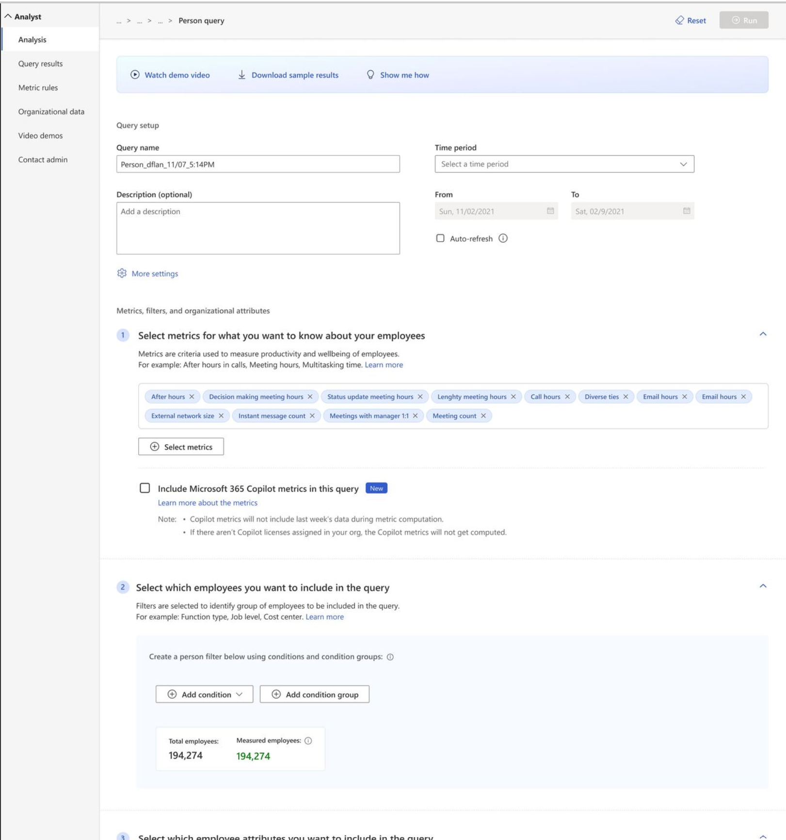
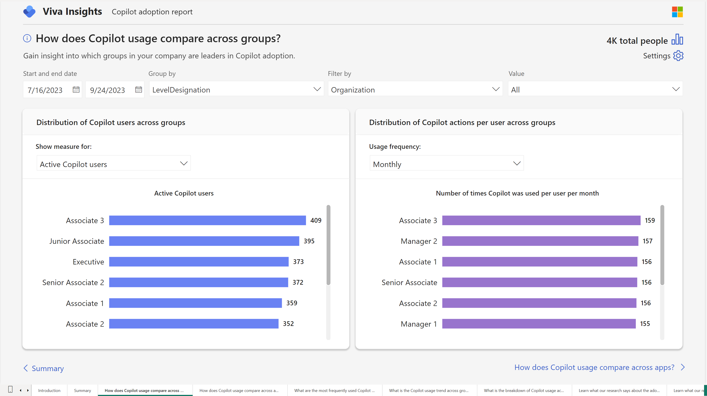
Copilot Solutions in Viva Insight
Analyst Workbench MVP
Analyst workbench | Premium Wide range of metrics, including scenarios Filter and group by using organizational data attributes Customizable solution PBI Template – Adoption and Impact
For all views:
Microsoft Copilot Dashboard now generally available - Microsoft Community Hub

Slide 38
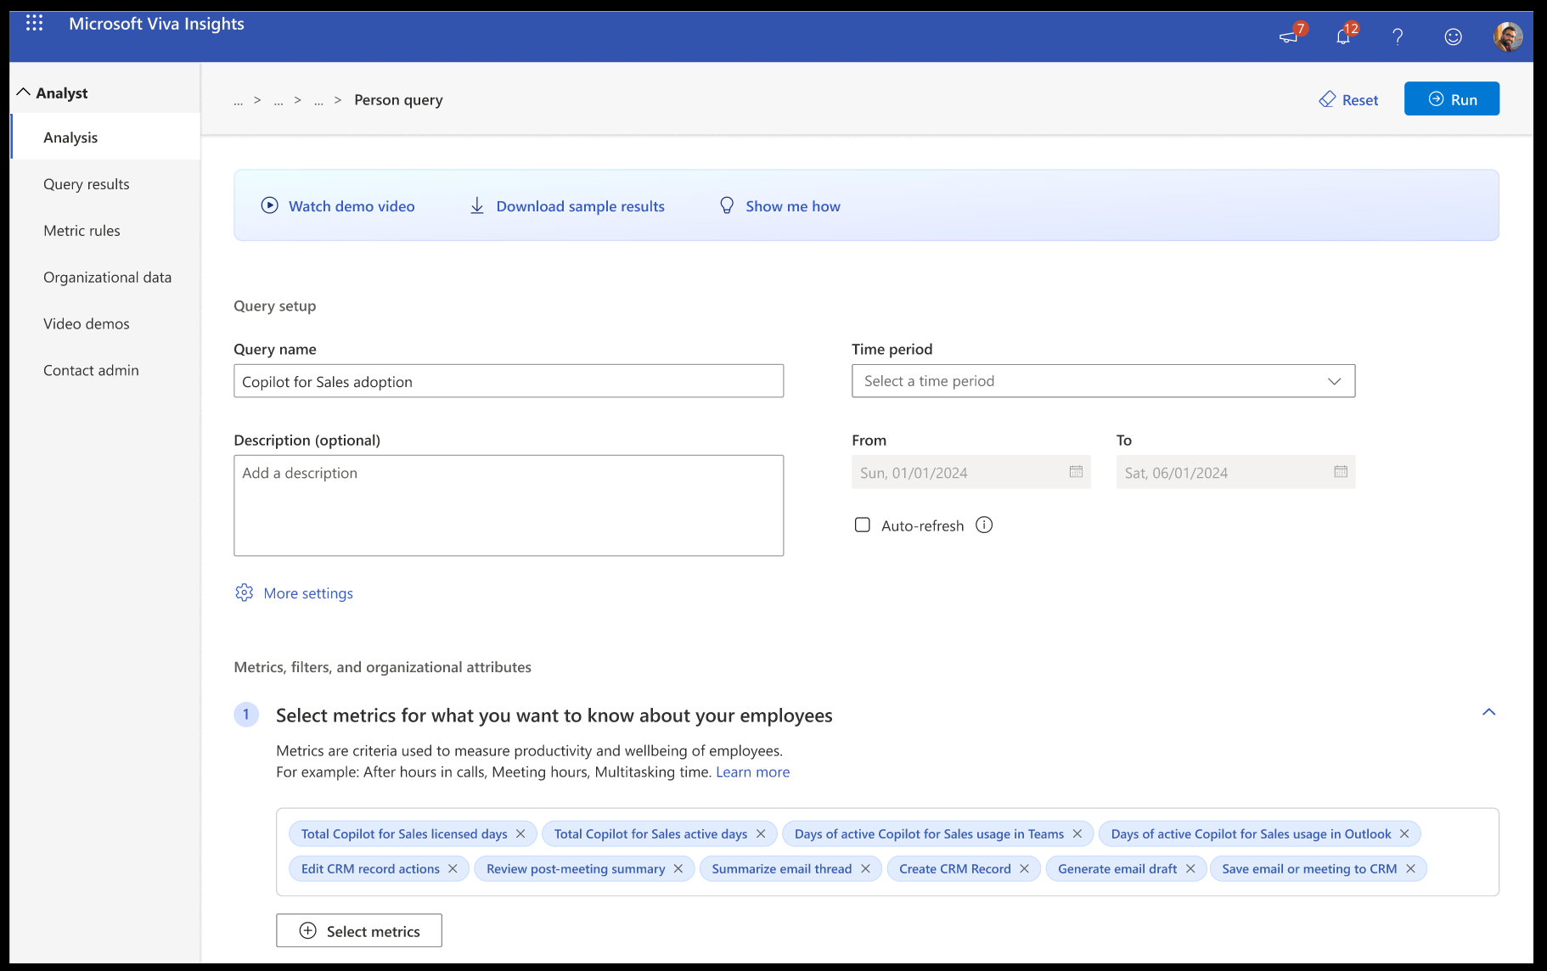
Copilot Solutions in Viva Insight
Analyst Workbench MVP
Notes:
Send list of filters

Slide 39









Copilot for Sales Overview
Copilot for Sales makes Microsoft 365 speak Sales
Copilot for Sales is a role-based Copilot that meets sellers where they do their work.
Microsoft
Copilot for Sales
Copilot for Sales is an AI-driven sales assistant that empowers sellers with insights, recommendations, actions, and up-to-date CRM data across all M365 apps.
Microsoft
Copilot for Microsoft 365
Copilot for Microsoft 365 is included in Copilot for Sales
If you purchase Copilot for Sales,
you get Copilot for Microsoft 365.
Copilot for Microsoft 365 is a personal AI-powered productivity tool that combines the power of large language models (LLMs) with your data in the Microsoft Graph
Connects with Your CRM
Natively connects to Salesforce
and Dynamics 365 Sales.

Slide 40

Copilot for Sales Experiences
App Chat
Embedded AI
Contextual Side Car
Microsoft 365 Chat
Outlook
Outlook
Outlook
Microsoft 365
Copilot
Email summary
Sales
Copilot
Copilot
Sales
Sales
Microsoft 365 Chat
Sales
How can I help?
How can I help?
How can I help?
Ask questions of your CRM data in the context of customer emails and appointments.
Write better emails with
AI-generated content infused with enrichments from your CRM.
Blend CRM data with your Microsoft 365 data using natural language right from the home for Microsoft 365.
Curated CRM data, insights, and suggested actions in the context of the email you’re reading/writing*

Slide 41












Copilot for Sales Architecture
Apps
PowerPoint
OneNote
Excel
M365 Chat
Outlook
Teams
Word
Experiences
App Chat
Embedded AI
Contextual Side Car
Microsoft 365 Chat
Copilot for Sales skills
Copilot experiences across all surfaces are powered by a shared set of skills that ensures consistency and reliability.
Trust
Responsible AI
Copilot for Sales
Sales Meetings Skills
Sales E-Mails
Skills
CRM Sales
Entity Skills
Deal Room
Skills
Settings & Configuration
New Extension
Skills
AI
Data
Azure Open AI Service
Large Language Models
Graph
M365 Data
CRM
Customer Data
Copilot Studio
Extension Data

Slide 42
Bring your own data to Copilot for Sales
Configuration
Extensions
Connect your CRM Data
Build your Own Extension
Use Third-Party Extensions
CRM Admins can bring custom fields and entities from the CRM to be included into existing Copilot for Sales experiences via point and click configuration page.
Makers can build their own Copilot for Sales Power Platform Connectors and connect it to Copilot for Sales via Copilot Studio Plugins to bring additional data into Copilot for Sales.
Admins can enable existing third-party Power Platform Connectors and connect it to Copilot for Sales
via Copilot Studio Plugins to bring additional data into Copilot for Sales.
Extensions can either enrich existing Copilot for Sales skills or introduce net new skills that can surface in Microsoft 365 Copilot Chat or App Chat.

Slide 43


Copilot Extensions Overview
Dynamics Apps
M365 Apps
M365 Chat
Teams
Copilot in Dynamics
Copilot For Sales
ISV Scoped Copilot
ISV Scoped Copilot
Contextual Experiences
Chat
Embedded
AI
Contextual
Side Car
M365 Chat
M365 Chat
M365 Chat
Teams App
ISV Extensions
Enrich existing Skills
ISV Extensions
Net New Skills (Prompt Based)
ISV Extensions
Enrich existing Skills
ISV Extensions
Net New Skills (Prompt Based)
ISV Extensions
Net New Skills (Prompt Based)
ISV Extensions
Net New Skills (Prompt Based)
ISV Extensions
Teams App Extensions
ISV Plugins
Copilot
Studio
Visual Studio
Code
ISV Connectors
ISV Services

Slide 44
Copilot for Sales Extension Architecture
Apps
PowerPoint
OneNote
Excel
M365 Chat
Outlook
Teams
Word
Experiences
App Chat
Embedded AI
Contextual Side Car
Microsoft 365 Chat
Configuration
Once a custom CRM field or entity is configured, it will surface across all Copilot for Sales Skills and end-user experiences.
This is done by an admin via a point and click configuration page.
Copilot for Sales
Sales Meetings Skills
Sales E-Mails
Skills
CRM Sales
Entity Skills
Deal Room
Skills
Settings & Configuration
New Extension
Skills
AI
Data
Azure Open AI Service
Large Language Models
Graph
M365 Data
CRM
Customer Data
Copilot Studio
Extension Data
Custom CRM Fields and Entities

Slide 45
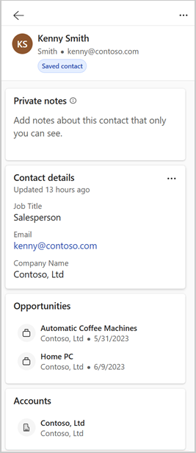
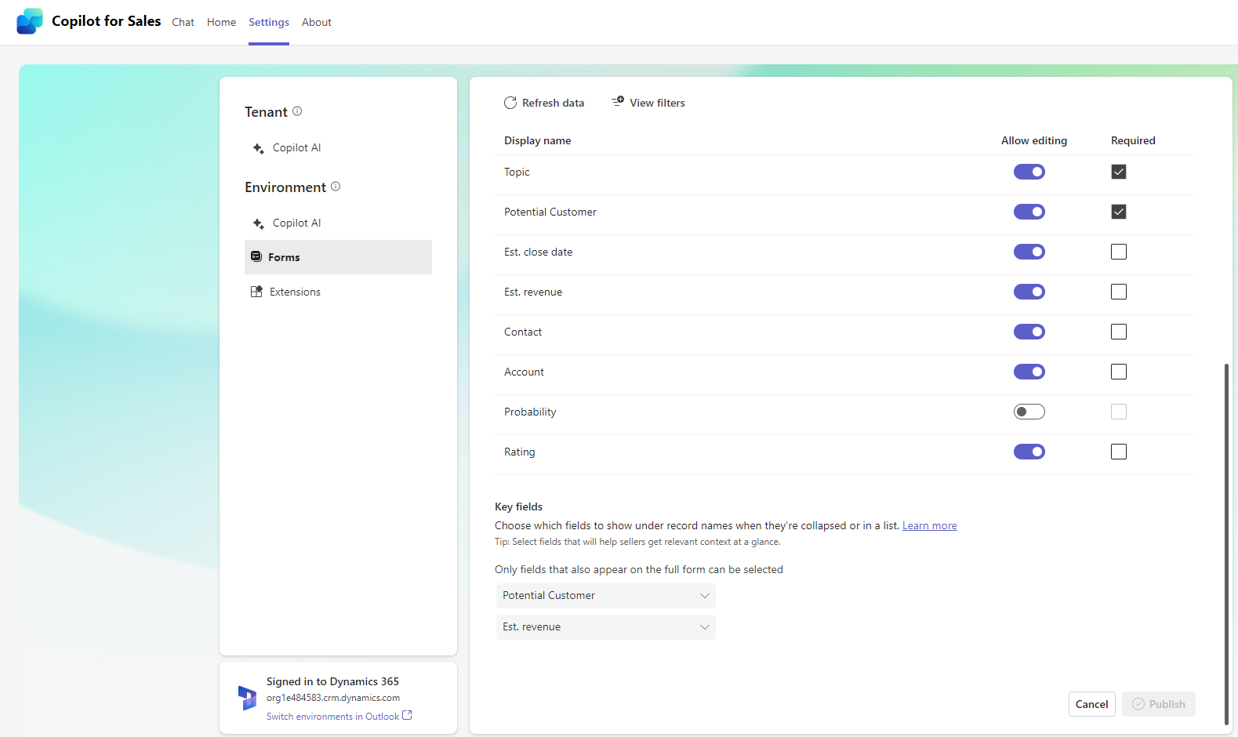
Copilot for Sales Extension Architecture
Configuration
Once a custom CRM field or entity is configured, it will surface across all Copilot for Sales Skills and end-user experiences.
This is done by an admin via a point and click configuration page.

Slide 46
Copilot for Sales Extension Architecture
Apps
PowerPoint
OneNote
Excel
M365 Chat
Outlook
Teams
Word
Extensions
Customers can build their own or use existing third-party extensions to enrich existing out-of-box Copilot for Sales Skills with their own data.
For example, an extension can be provided to surface relevant sales agreement documents for a specific opportunity summary or add a reference to a product catalog when using AI to generate an e-mail reply to a customer inquiry.
Experiences
App Chat
Embedded AI
Contextual Side Car
Microsoft 365 Chat
Copilot for Sales
Sales Meetings Skills
Sales E-Mails
Skills
CRM Sales
Entity Skills
Deal Room
Skills
Settings & Configuration
New Extension
Skills
AI
Data
Azure Open AI Service
Large Language Models
Graph
M365 Data
CRM
Customer Data
Copilot Studio
Extension Data
Custom Extensions

Slide 47
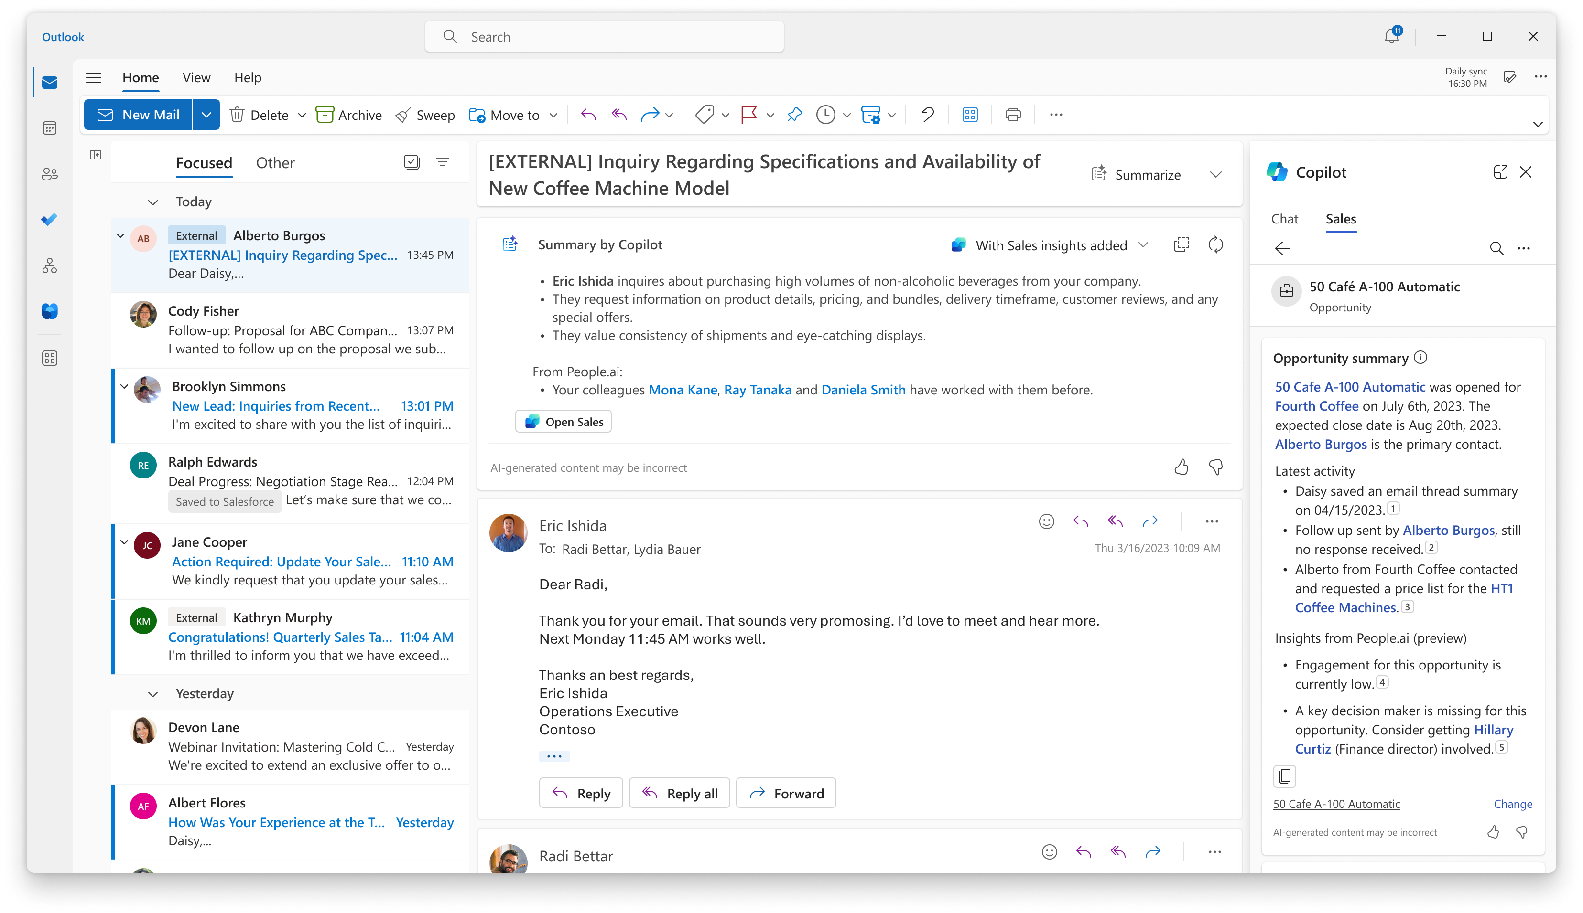
Copilot for Sales Extension Architecture
Extensions
Customers can build their
own or use existing third-party extensions to enrich existing
out-of-box Copilot for Sales Skills with their own data.
For example, an extension can
be provided to surface relevant sales agreement documents for
a specific opportunity summary
or add a reference to a product catalog when using AI to generate an e-mail reply to a customer inquiry.

Slide 48
Copilot for Sales Extension Architecture
Apps
PowerPoint
OneNote
Excel
M365 Chat
Outlook
Teams
Word
Experiences
App Chat
Embedded AI
Contextual Side Car
Microsoft 365 Chat
Extensions
Customers can build their
own or use existing third-party extensions to introduce net new skills into Microsoft 365 Chat.
Copilot for Sales
Sales Meetings Skills
Sales E-Mails
Skills
CRM Sales Entity Skills
Deal Room
Skills
Settings & Configuration
New Extension
Skills
AI
Data
Azure Open AI Service
Large Language Models
Graph
M365 Data
CRM
Customer Data
Copilot Studio
Extension Data
Custom Extensions

Slide 49
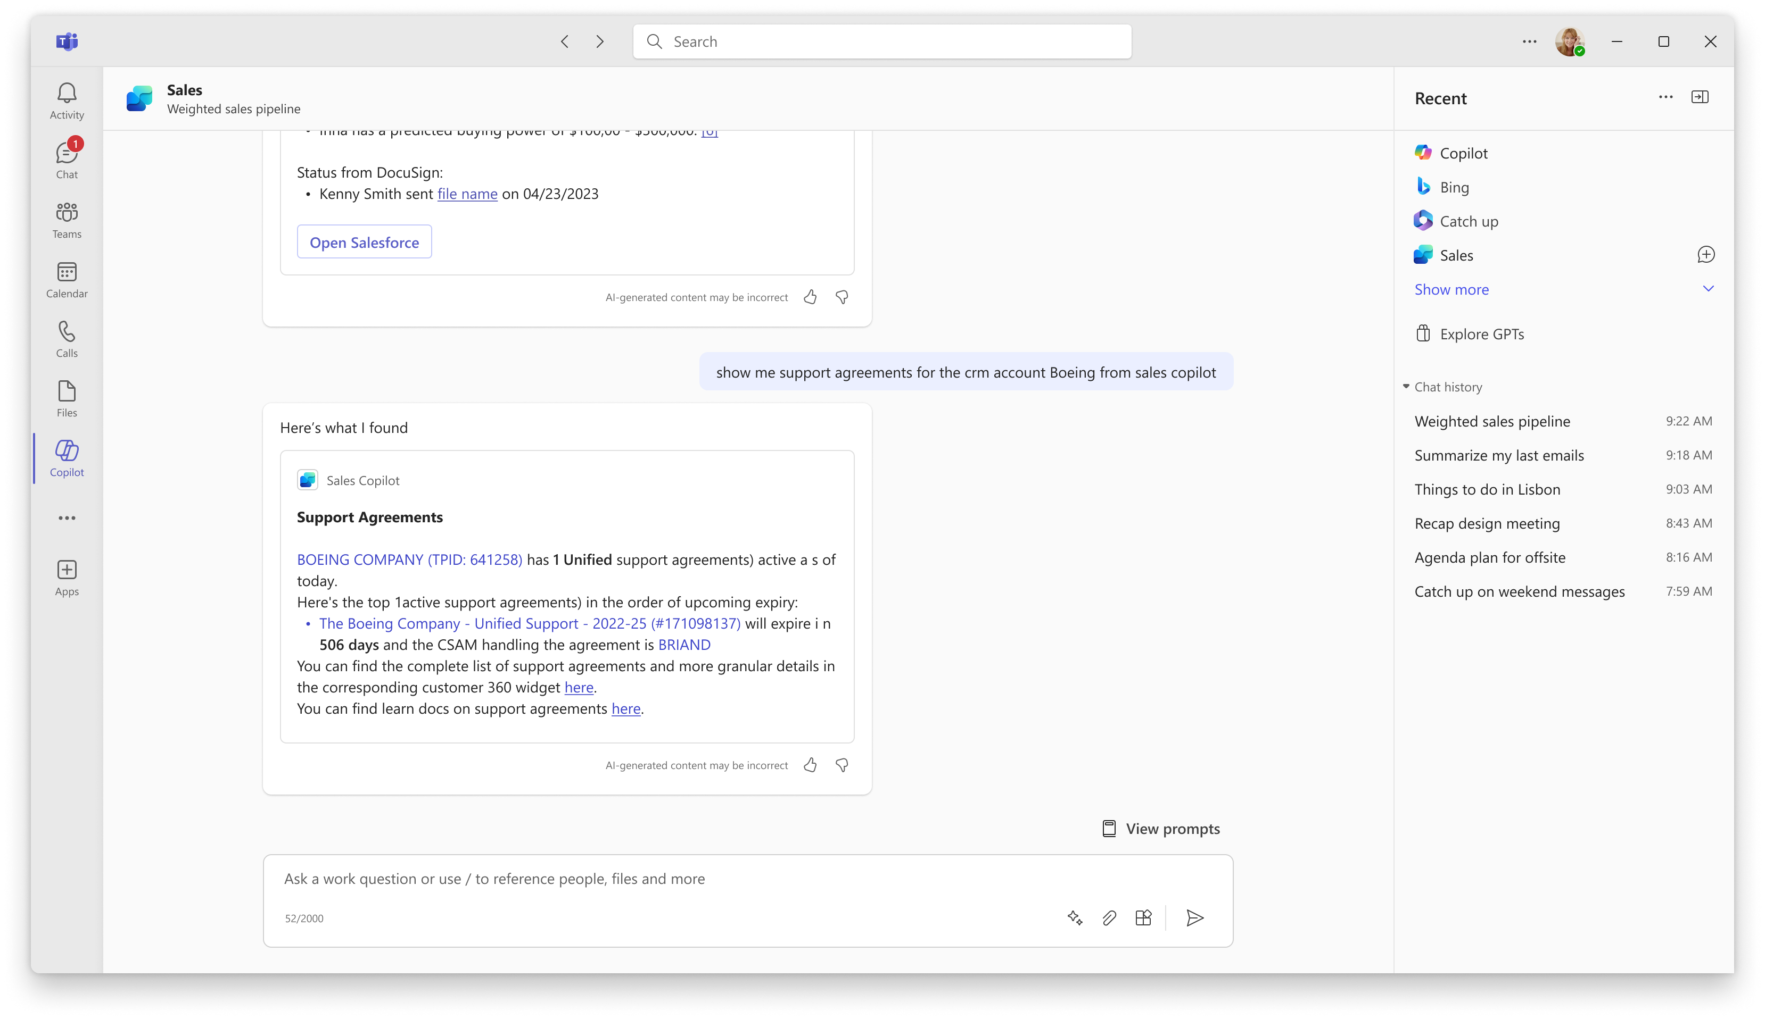
Copilot for Sales Extension Architecture
Extensions
Customers can build their own or use existing third-party extensions to introduce net new skills into Microsoft 365 Chat.

Slide 50
Extending Copilot for Sales Experiences
Enrich existing Copilot for Sales skills that are surfaced across the various Copilot for Sales
experiences or build net new skills that can surface in Microsoft 365 Copilot Chat or App Chat.
App Chat
Embedded AI
Contextual Side Car
Microsoft 365 Chat
Outlook
Outlook
Outlook
Microsoft 365
Copilot
Email summary
Sales
Copilot
Copilot
Sales
Sales
Microsoft 365 Chat
Sales
How can I help?
How can I help?
How can I help?
How can I help?

Slide 51
Building Extensions

Slide 52
Copilot for Sales Extension Architecture
Apps
PowerPoint
OneNote
Excel
M365 Chat
Outlook
Teams
Word
Experiences
App Chat
Embedded AI
Contextual Side Car
Microsoft 365 Chat
Extensions
Customers can build their own or use existing third-party extensions to introduce net new skills into Microsoft 365 Chat.
Copilot for Sales
Sales Meetings Skills
Sales E-Mails
Skills
CRM Sales Entity Skills
Deal Room
Skills
Settings & Configuration
New Extension
Skills
AI
Data
Azure Open AI Service
Large Language Models
Graph
M365 Data
CRM
Customer Data
Copilot Studio
Extension Data
Custom Extensions

Slide 53
Building Extensions for Copilot for Sales
App Chat
Embedded AI
Contextual
Side Car
Microsoft 365 Chat
Enriched out-of-box skills
2. Add a Plugin
Plugins allow you to add schematic meaning to the data provided by connectors.
Introduce net new skills
Skill Orchestration
Copilot
for Sales
Existing out-of-box skills
New skills
Plugin Discovery and Configuration
1. Build or
Add Connector
Connectors allow you to bring your own or other third-party data to the Copilot ecosystem.
Enrich existing Copilot for Sales Skills with additional data and insights
Introduce new skills to surface in M365 and App Chat
Copilot
Studio
Plugins
Power
Platform
Custom Built Connector
Third-Party Connector

Slide 54
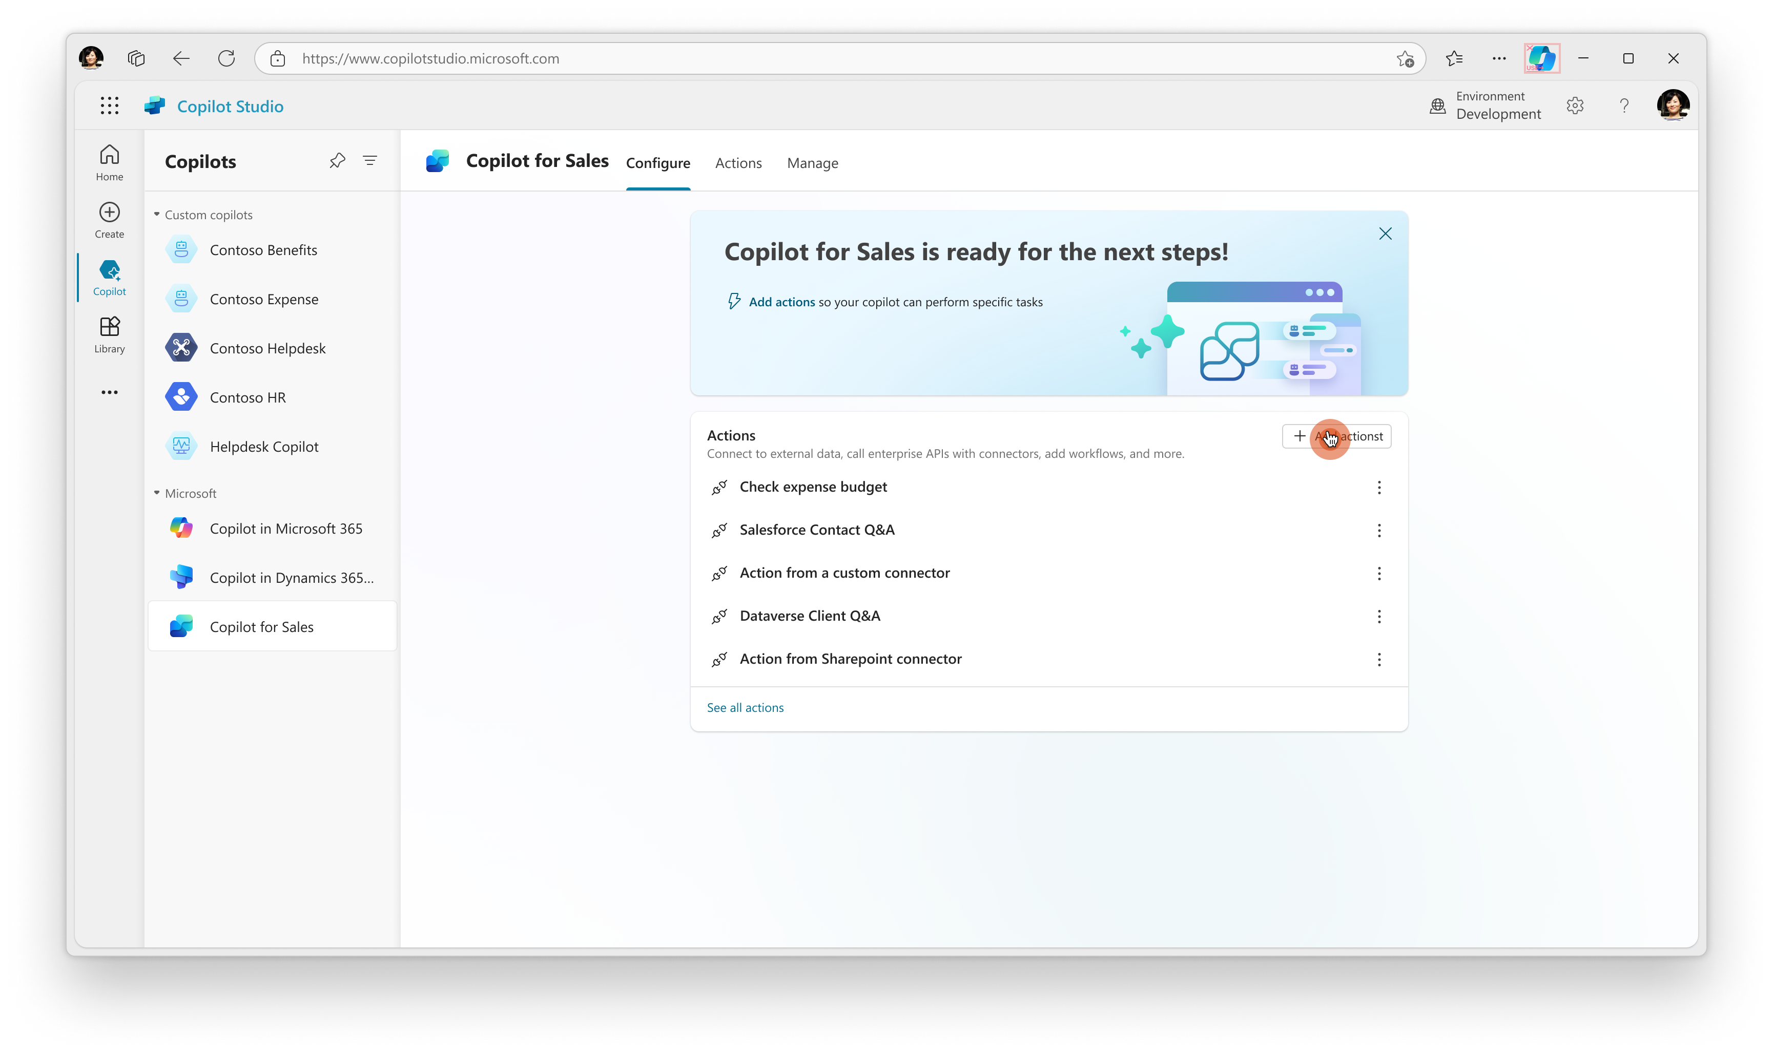
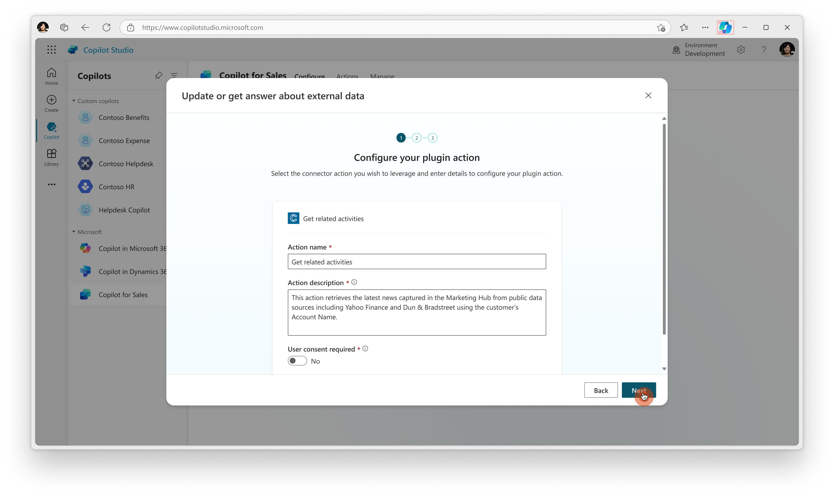
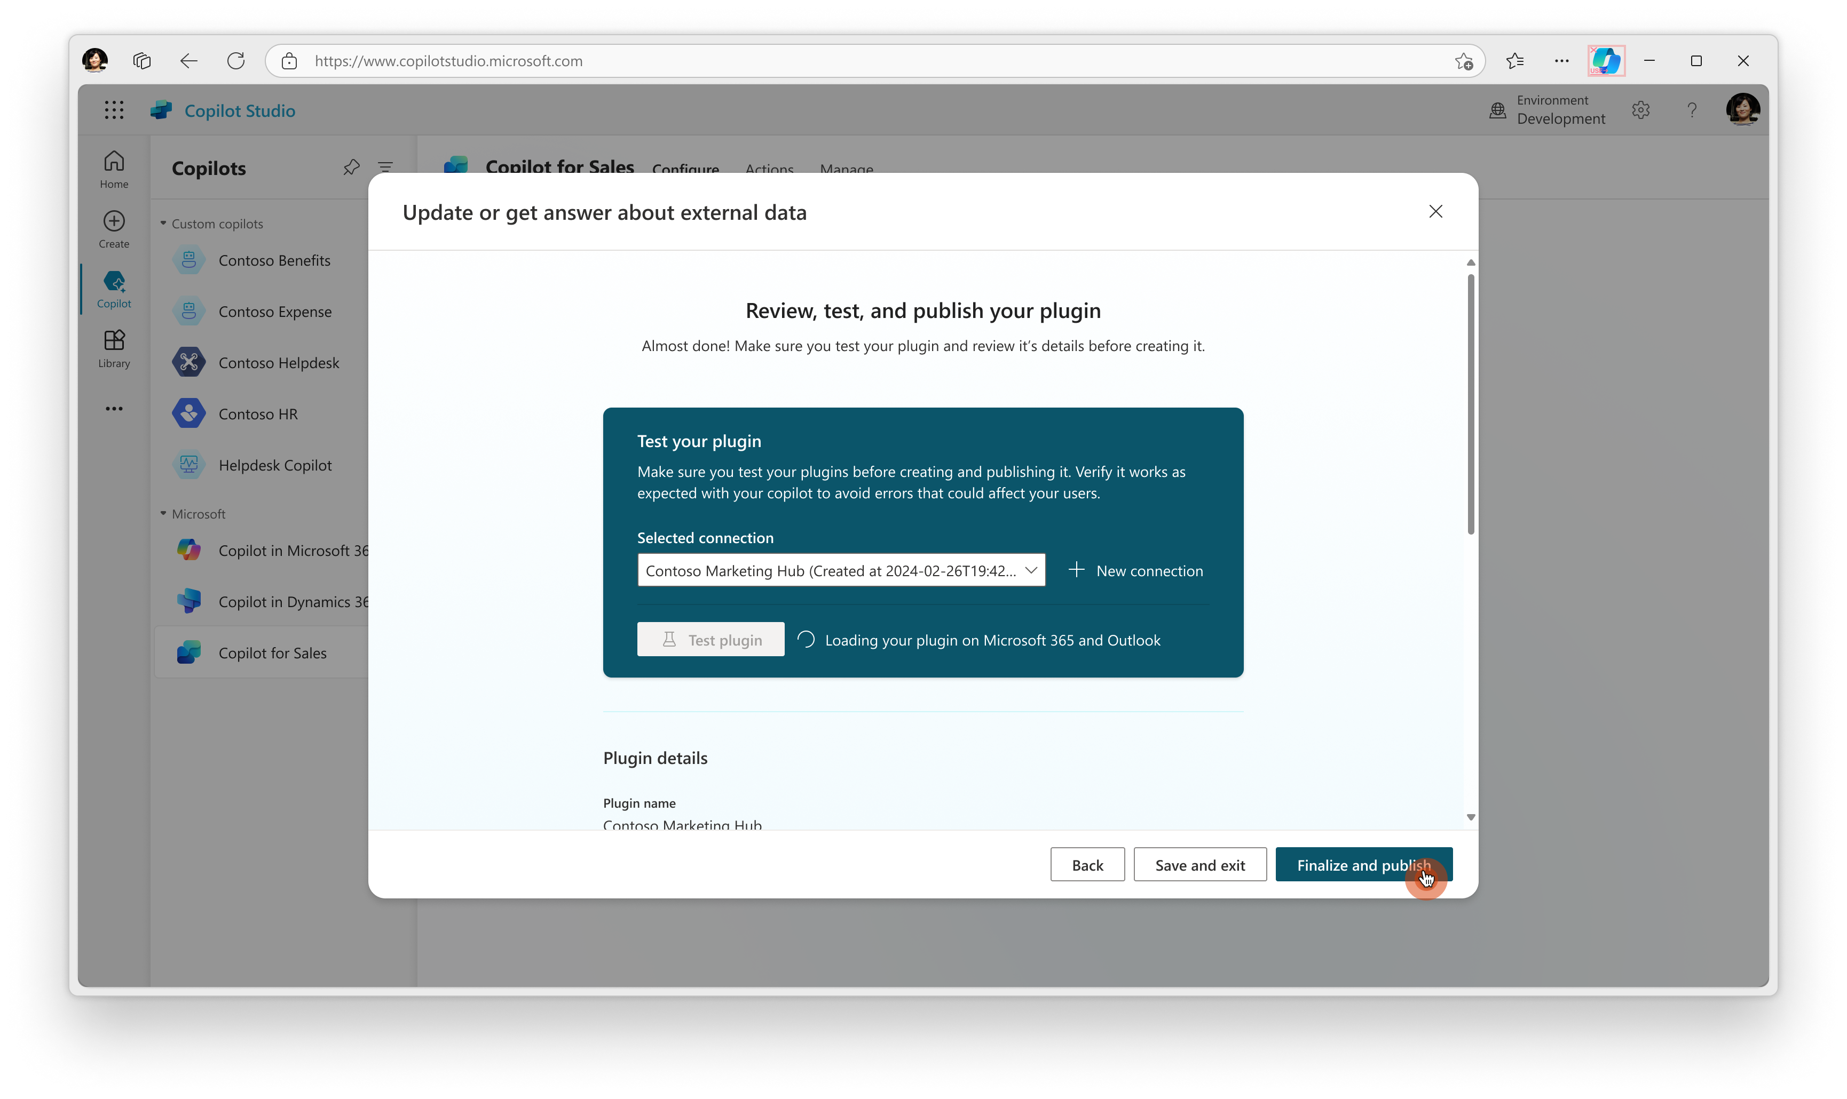
Building Extensions for Copilot for Sales
Add a Plugin
With the May update of Copilot Studio, there is native support
to extend Copilot for Sales through power platform connectors.
Customers and partners
can now build their own plugins
by either bring data and insights through their own custom built power platform connector or from one of the published third-party power platform connectors into
the various Copilot experiences.

Slide 55


Available Extension Points
Microsoft 365 Chat
Microsoft Outlook
Microsoft Teams
App specific skills
We are quickly introducing extensibility for all our app surface areas.
Introduce net new chat skills
Microsoft 365 Chat
Enrich E-Mail Summaries
Embedded AI
Enrich Key Sales Info
Contextual Side Car
Enrich CRM Details
Shared skills
Shared skills appear across multiple surface areas. Once extended,
your data will appear everywhere
the skills is surfaced.
Cross app shared skills
Enrich Entity Summaries

Slide 56
Thank you
© Copyright Microsoft Corporation. All rights reserved.

