Slide 1
Viva Connections overview

Slide 2
Table of contents
Introduction to Viva Connections
Experience walkthrough
Setup and configuration
Resources

Slide 3


Introduction

Slide 4

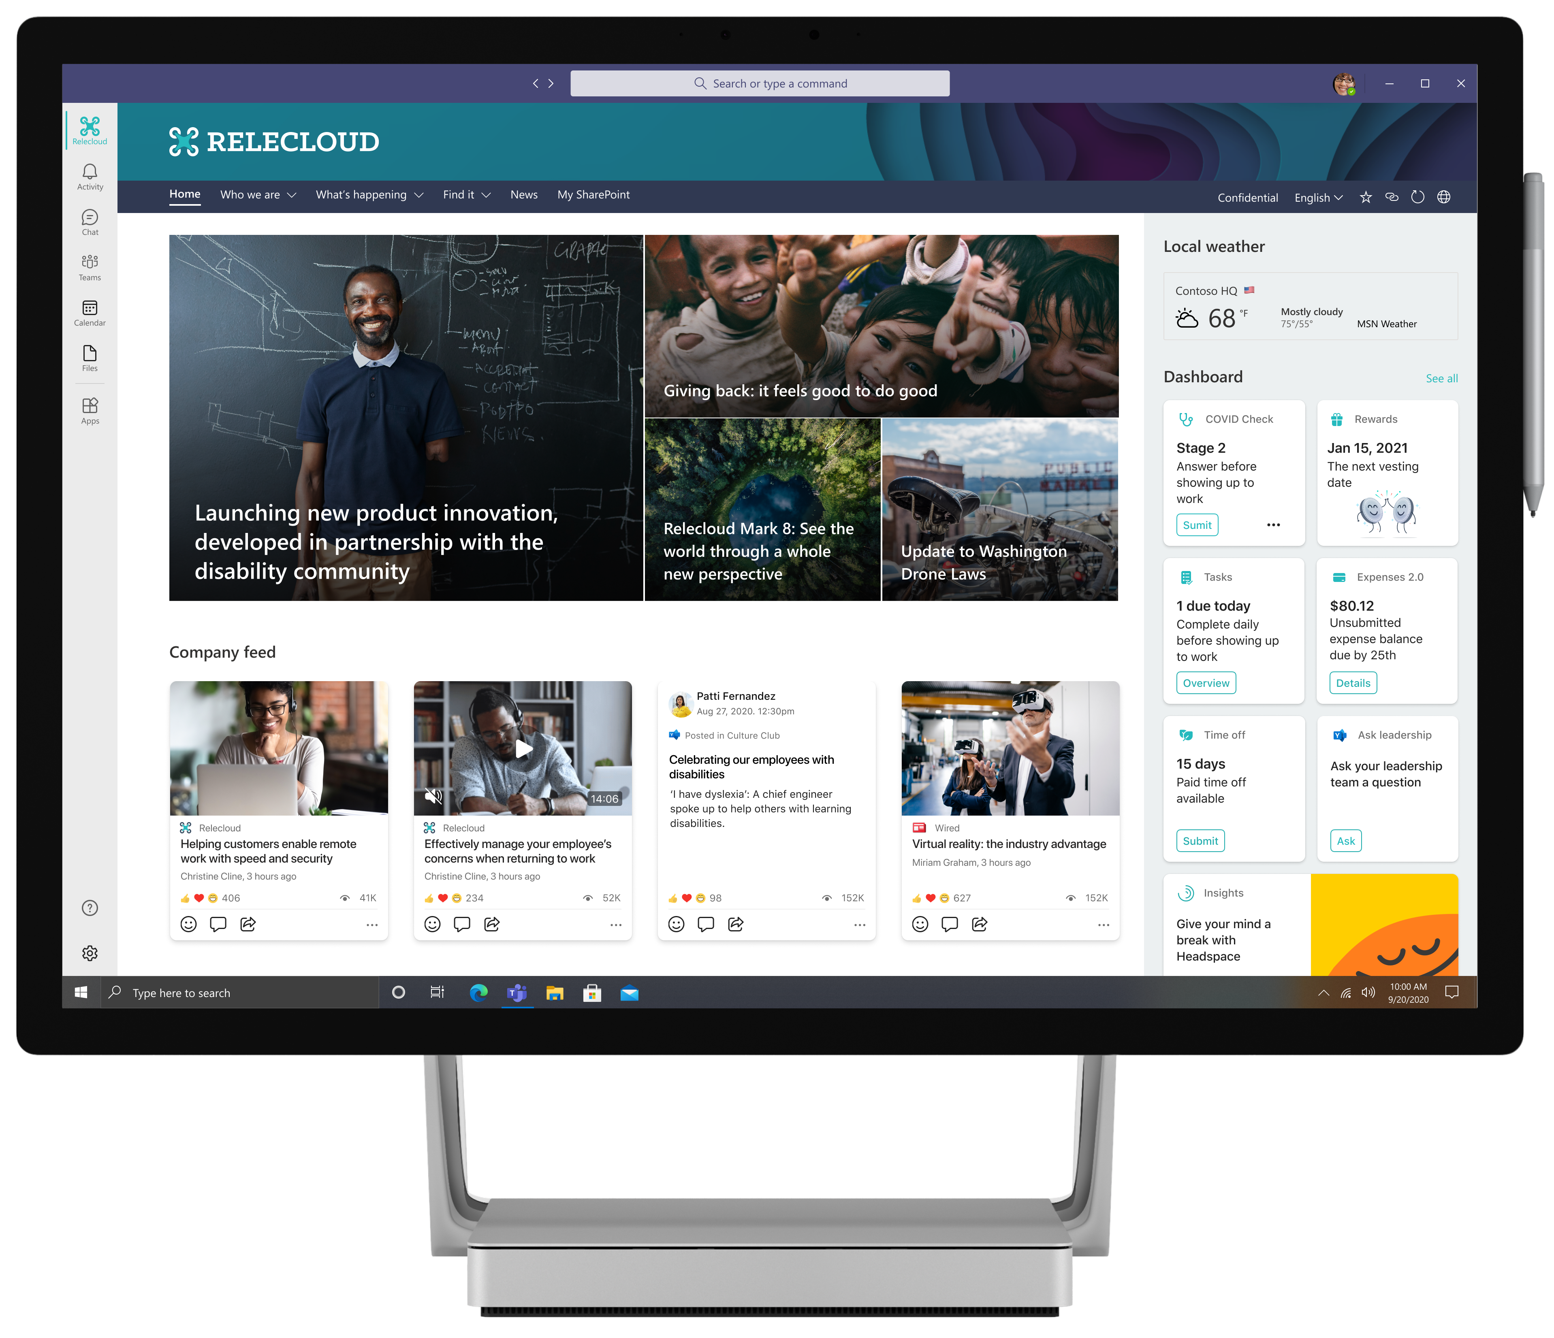
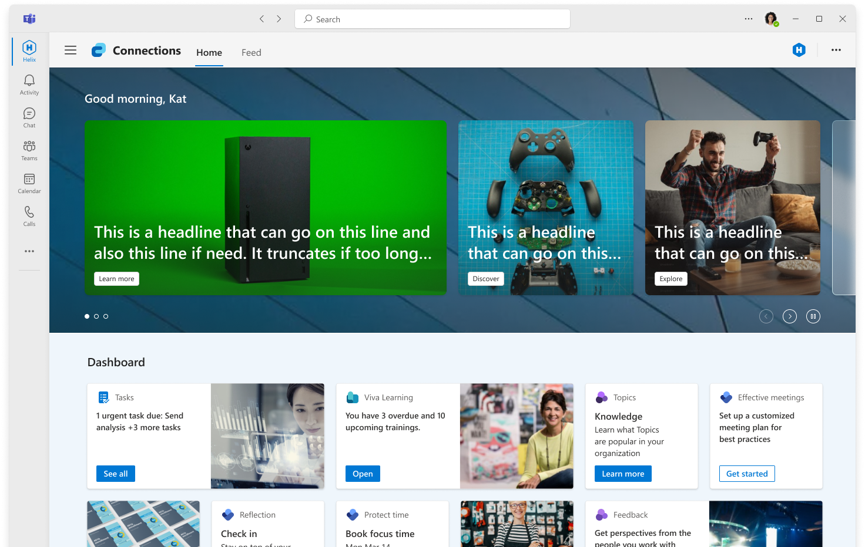
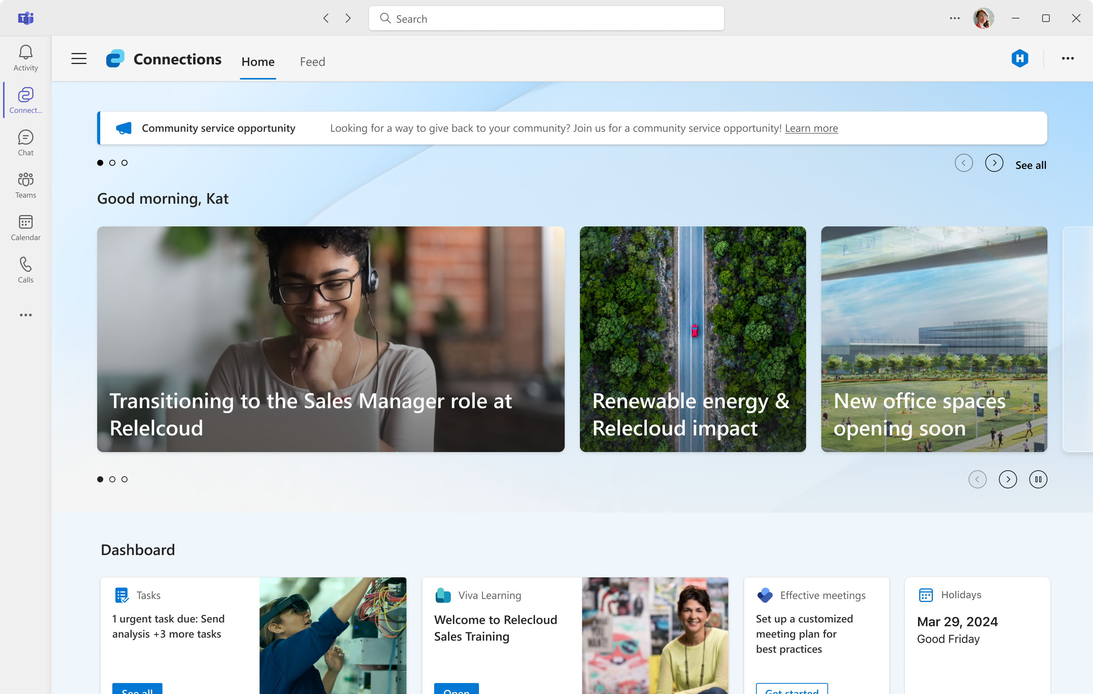
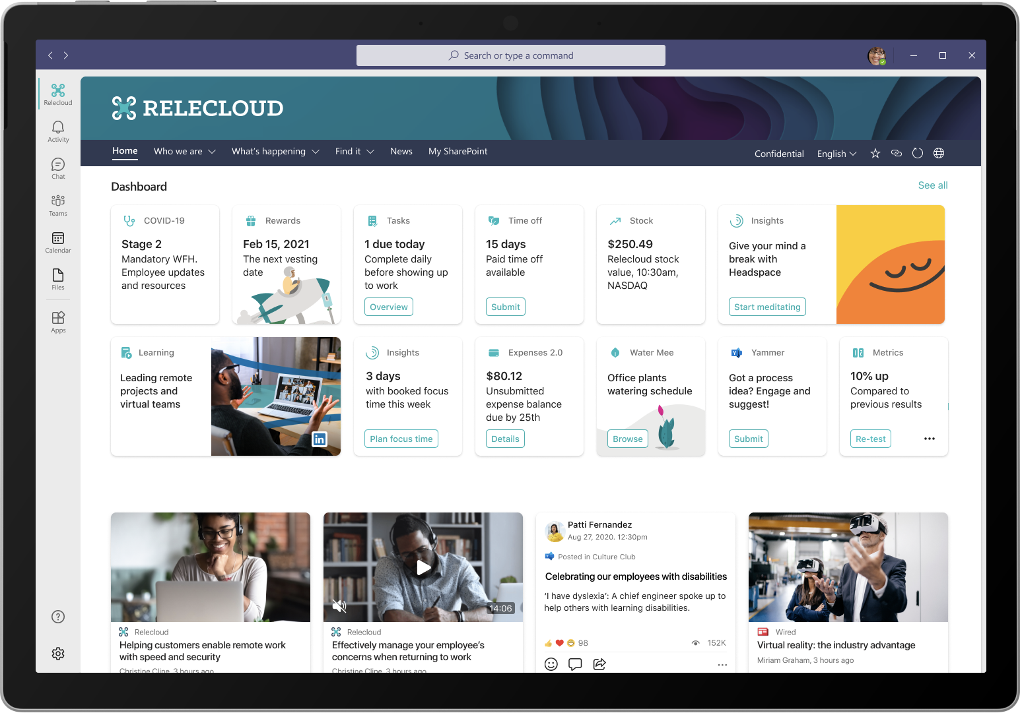
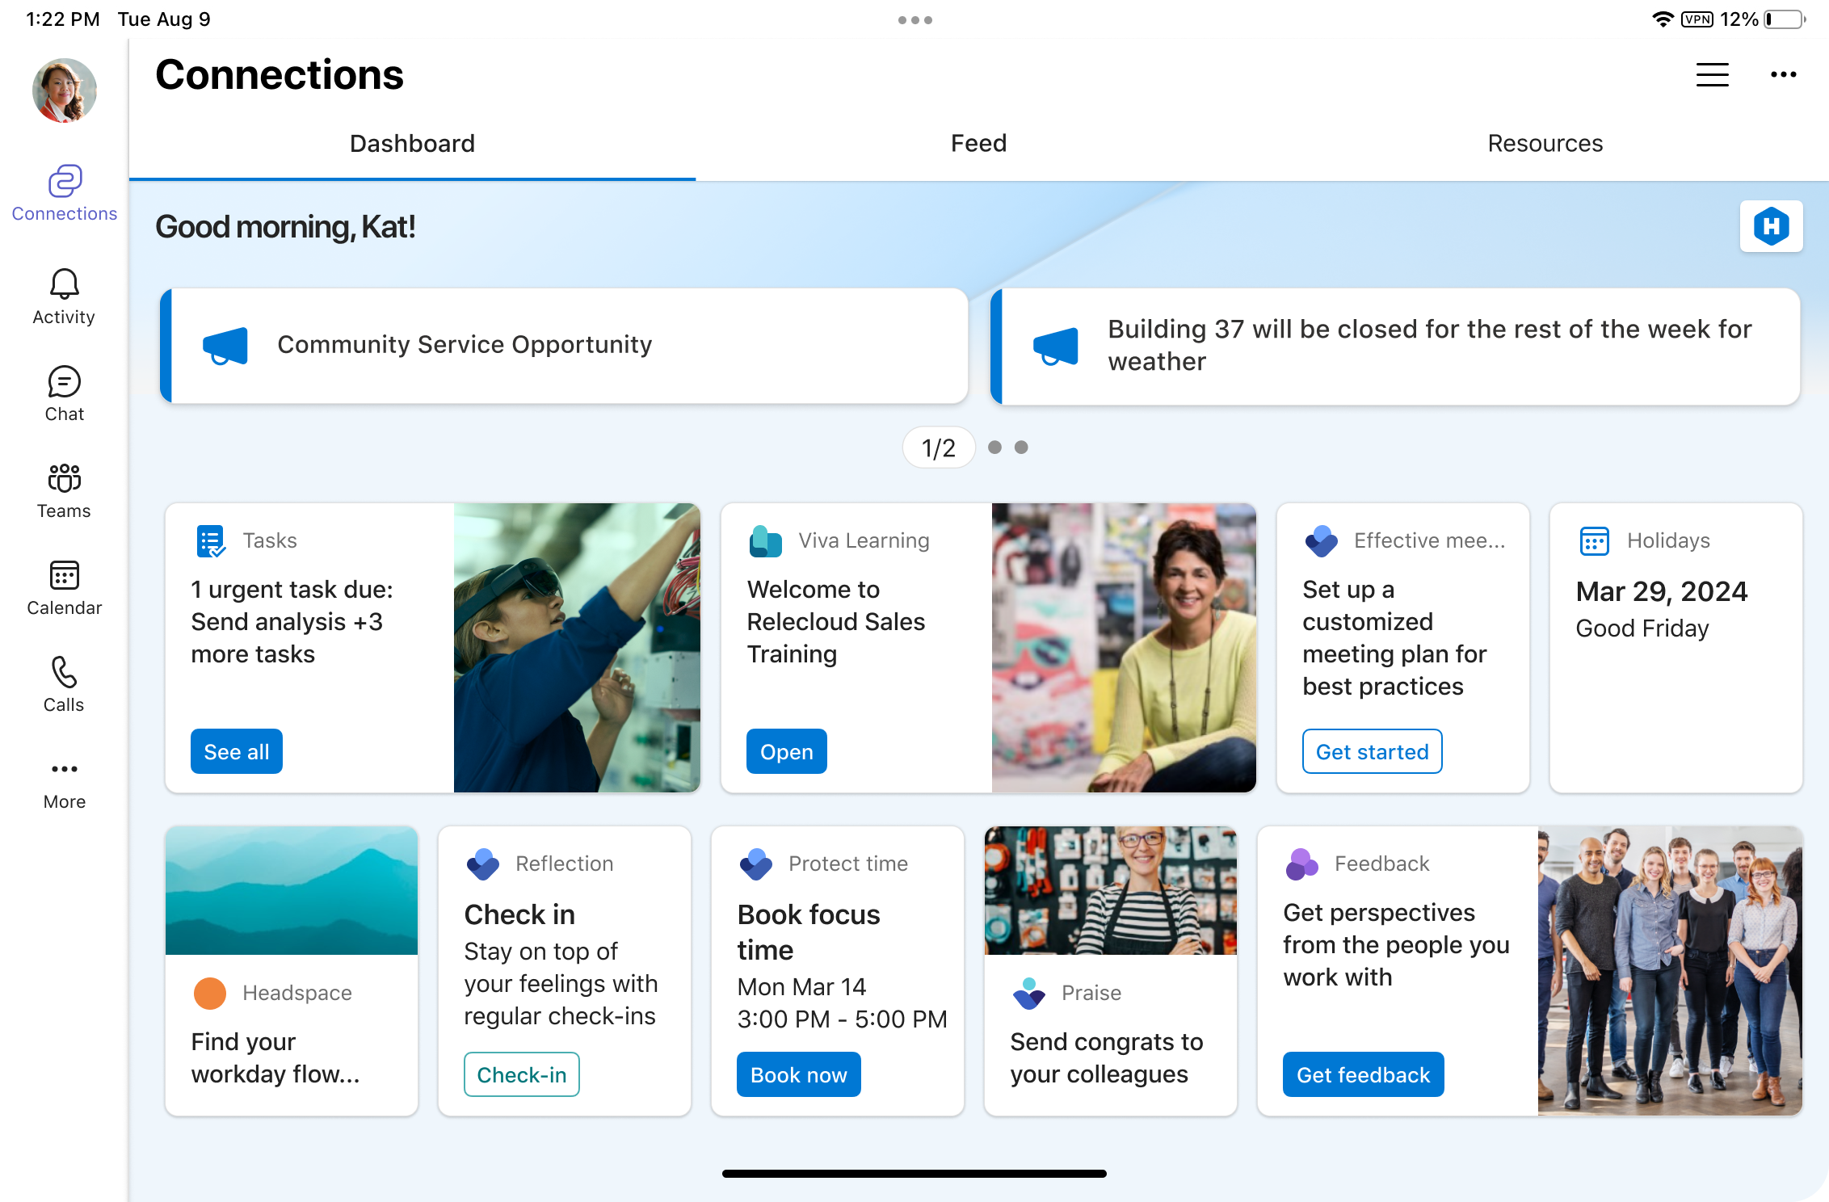
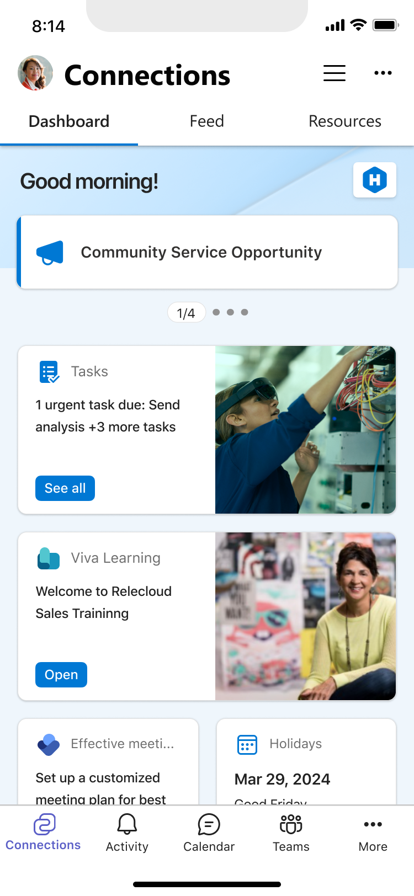
Viva Connections
People centered and branded employee experience across all device types
Tools and apps
Quick action, cohesive one-stop experience for all the apps in your organization – across all device types.
Customized for your organization
Curated to your organization and brand, including company and team updates and relevant industry news.
Personalized to the individual
Helping them be informed, stay connected, and feel engaged.

Slide 5
Experience walkthrough

Slide 6
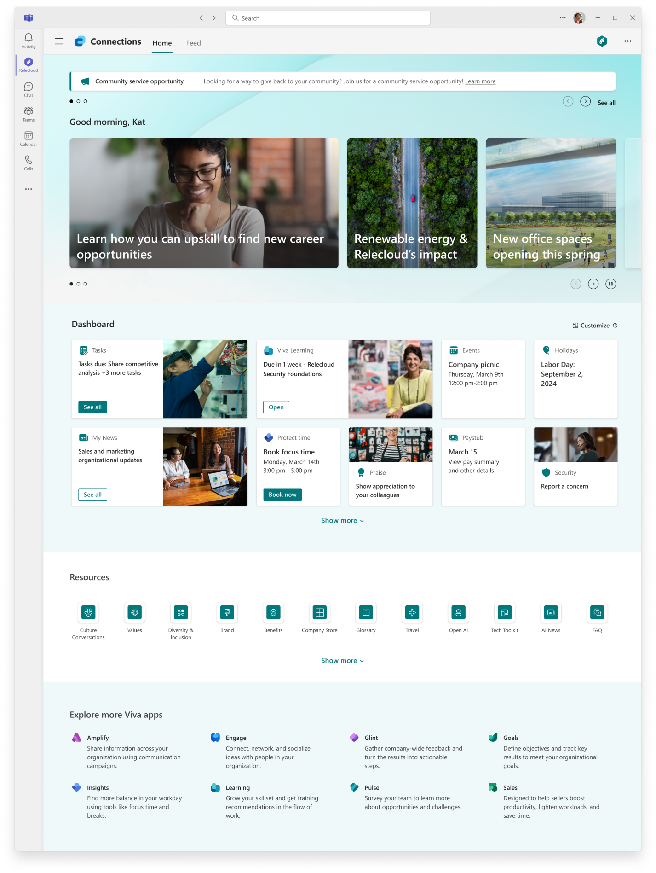
Connections on desktop
M365 Search
Home site
Branded app
Announcements
Feed pivot
Spotlight
Dashboard personalization
Dashboard cards
Resources
Viva Suite links
Notes:
Navigate various parts of your Viva Connections desktop dashboard.

Slide 7
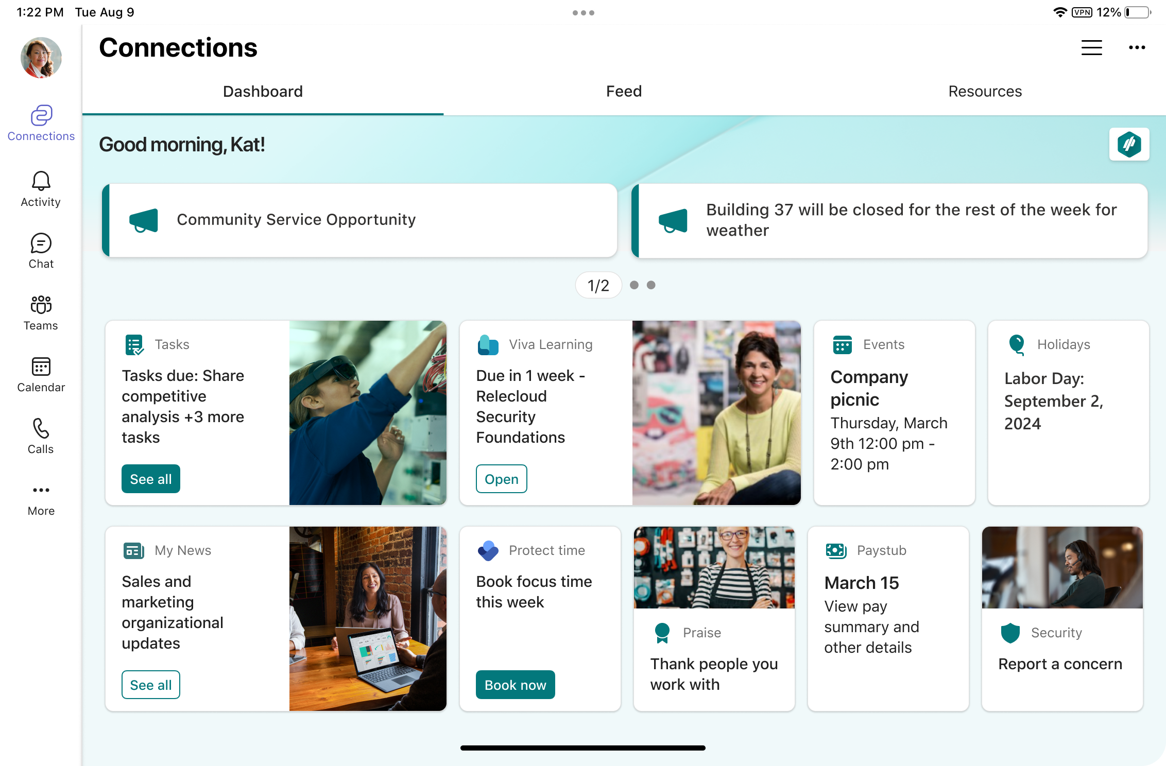
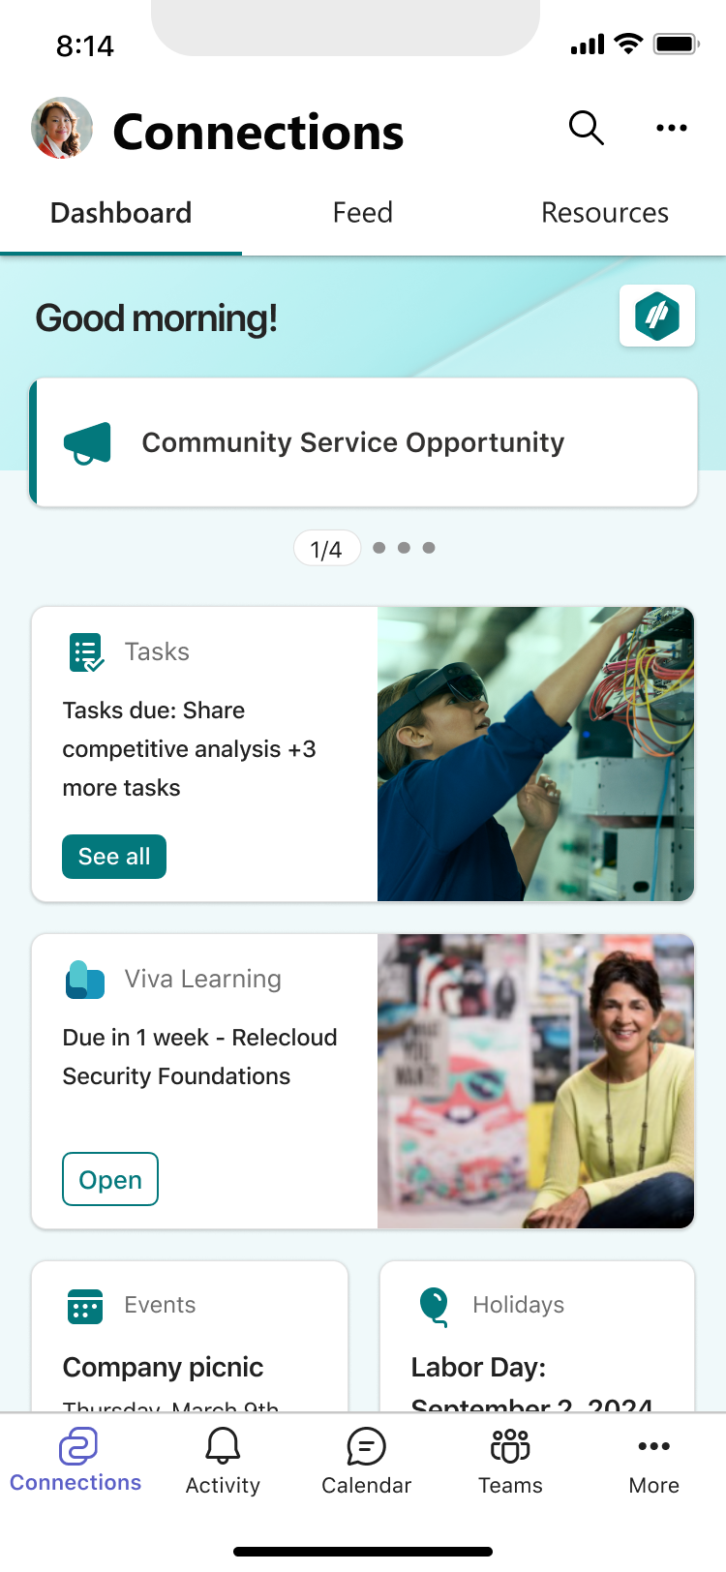
Connections on mobile & tablet
M365 Search
Feed / Resources
Home site
Announcements
Dashboard cards
Notes:
You can utilize Viva Connections on your mobile and tablet devices.

Slide 8
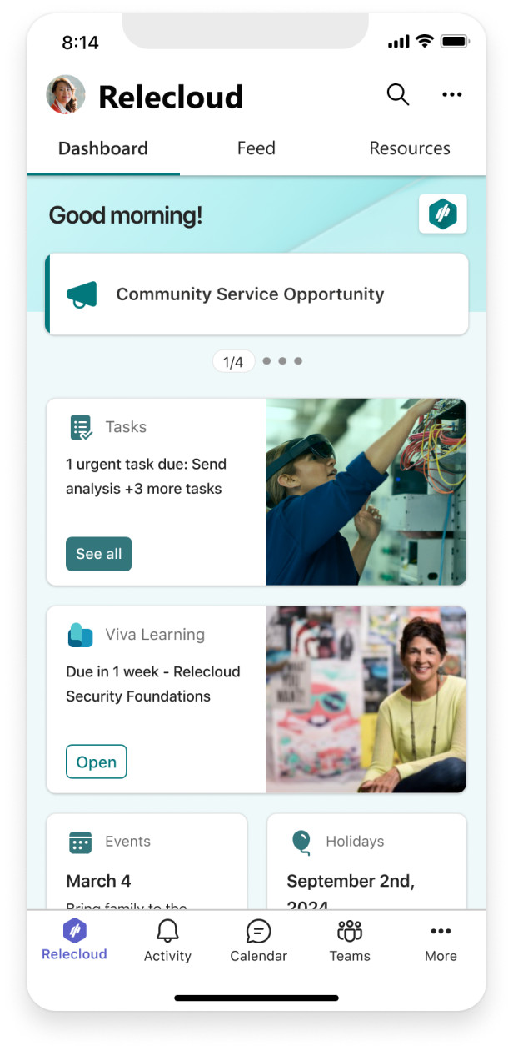
Top of intranet & Viva Connections complement each other
    Why is my Company amazing!
    Pixel perfect storytelling
    Navigate my entire company
    Search my entire company
    Tailored News to me
How do I be a part of my company?
    The most important news & community
    Employee Experience centered Apps
    Resources about employee support
    Connection to my Intranet
^{aka.ms/homesites}

Slide 9
Admin setup and configuration

Slide 10
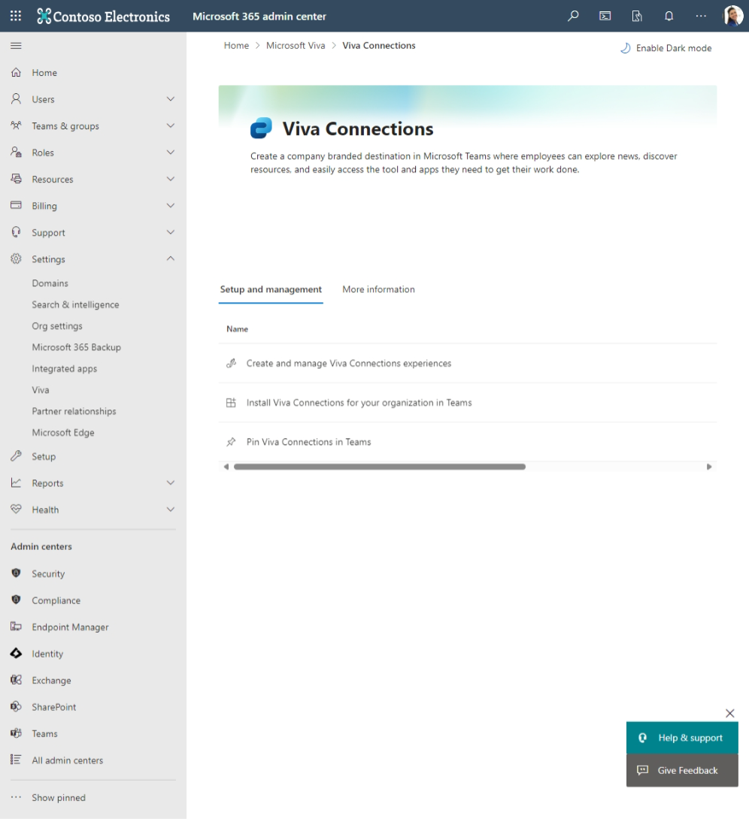
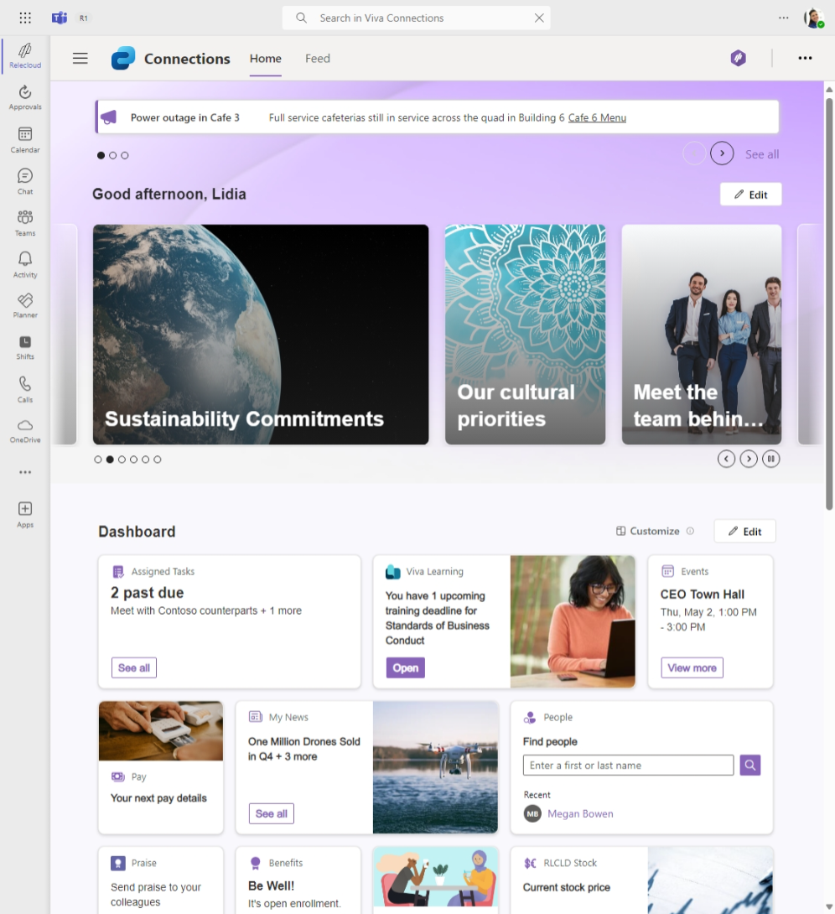
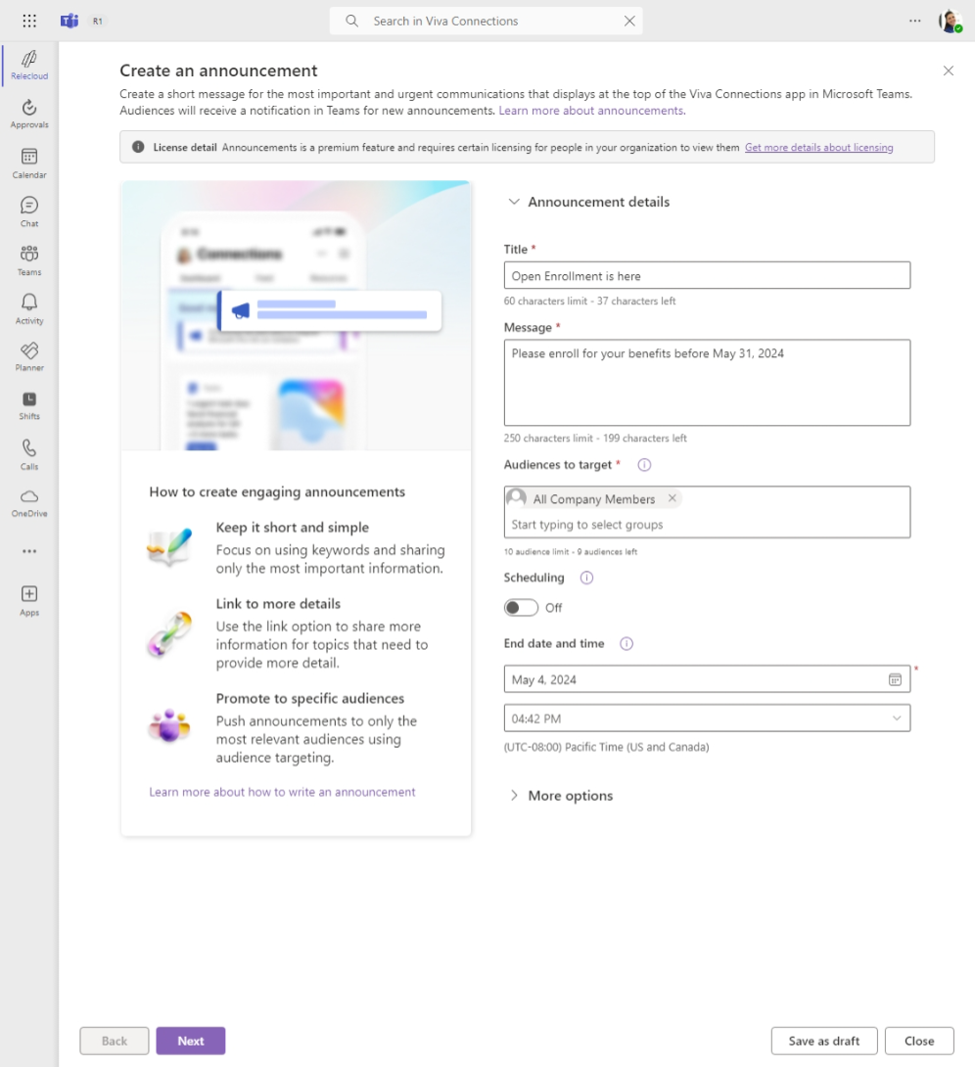
Setting up and configuring Connections experiences
Global, SharePoint and Teams Admins
Manage Connections experience lifecycle
Delegate experience management
Teams app policies and customizations (pinning, app brands)
Deploy Teams at Scale (FLW groups)
Brand Management
Connections Experience ‘Operator’
On canvas experience editing
Branding, themes, fonts
Dashboard authoring
Audience targeting
Resource curation
Spotlight management
Corporation Communications, HR, IT
Announcement authoring & targeting
News creation (Central & Regional)
Regular Spotlight content refreshes
Introduce & update dashboard cards

Slide 11
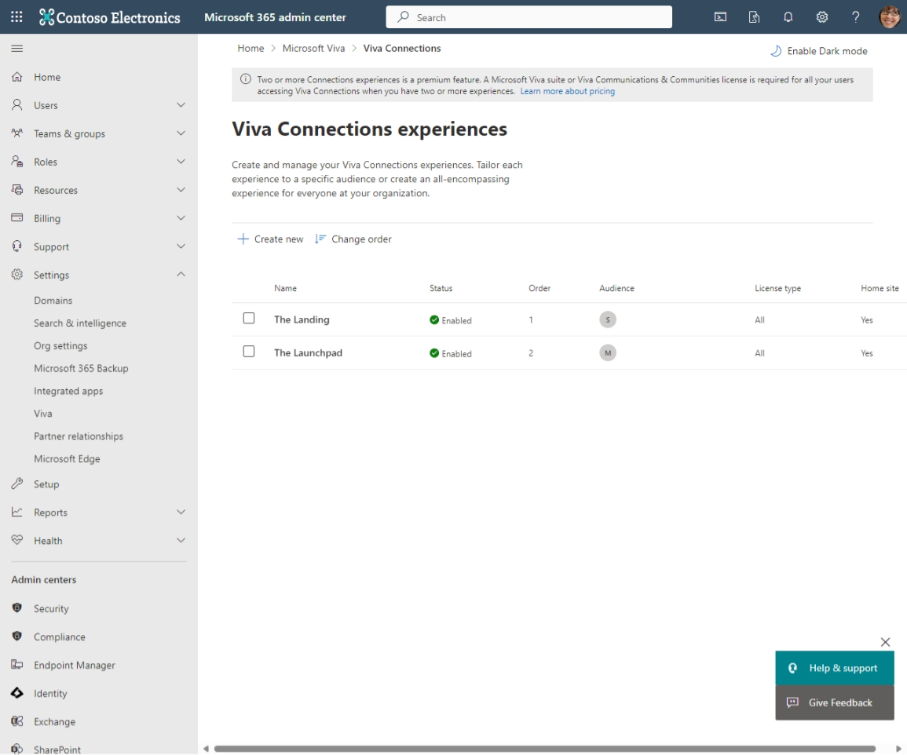
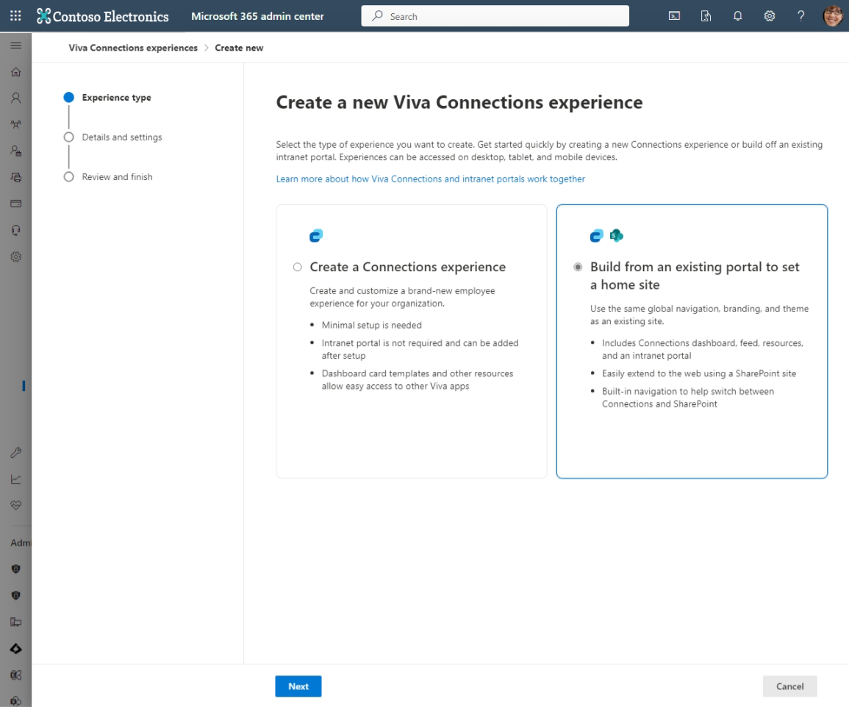
Manage Connections instances in M365 Admin Center
**Up to 50 unique experiences/home sites supported in a single tenant
Notes:
Create new Viva Connections experiences in this dashboard. Create a new Viva Connections experience to either build a Create a Connections experience or Build from an existing portal to set a home site.

Slide 12
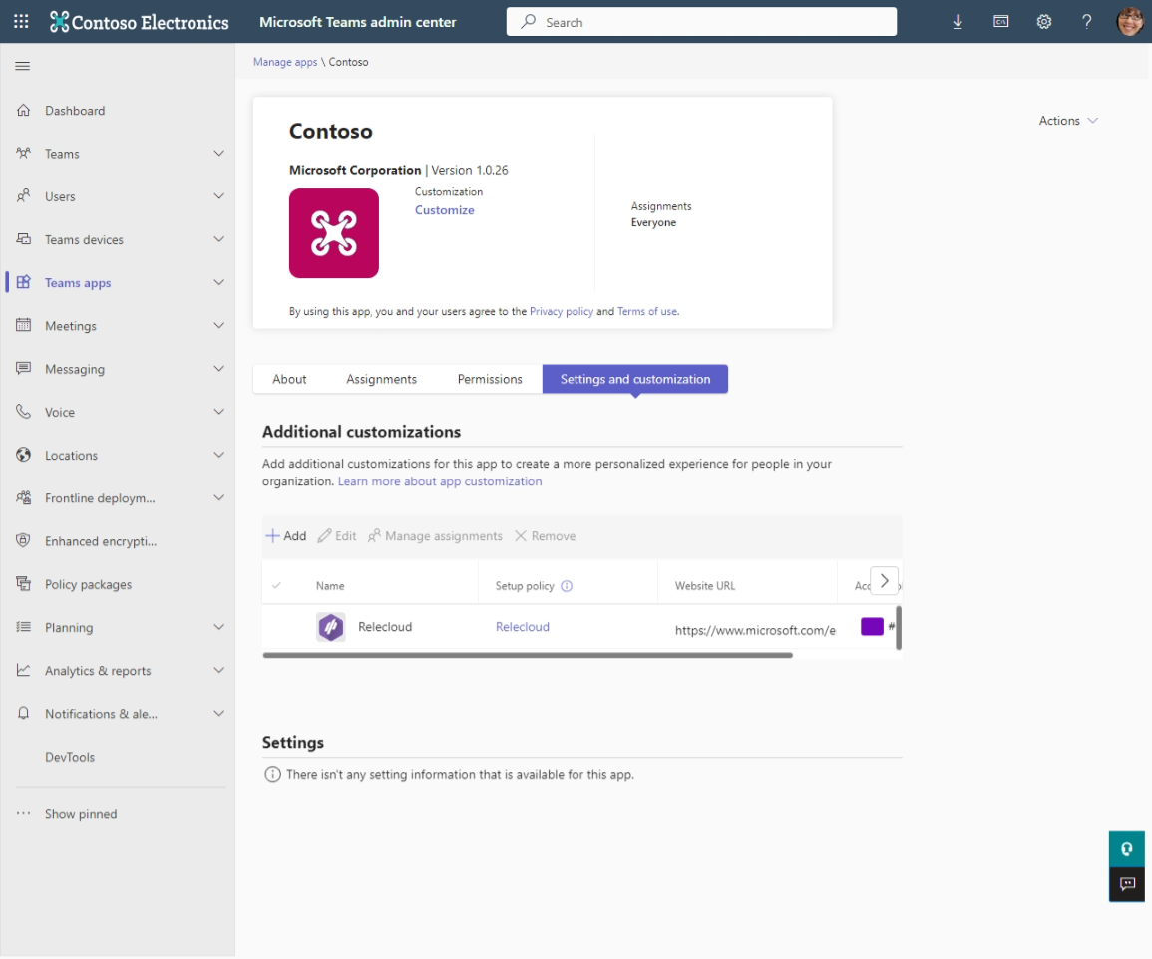
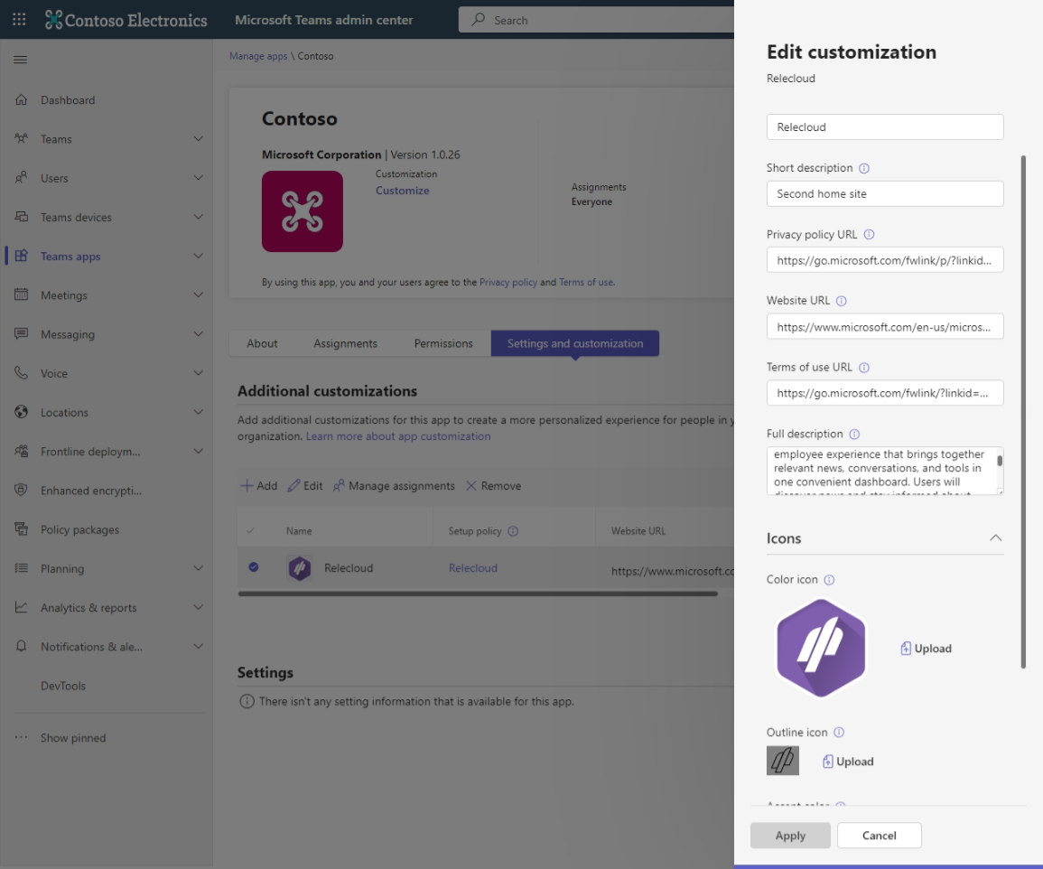
Connections app customization in Teams Admin Center
Notes:
Within Teams admin Center you can customize your Connections app by selecting Settings and customization. After selecting, you can edit your customization – including a Privacy policy URL, Terms of use URL, and more.

Slide 13
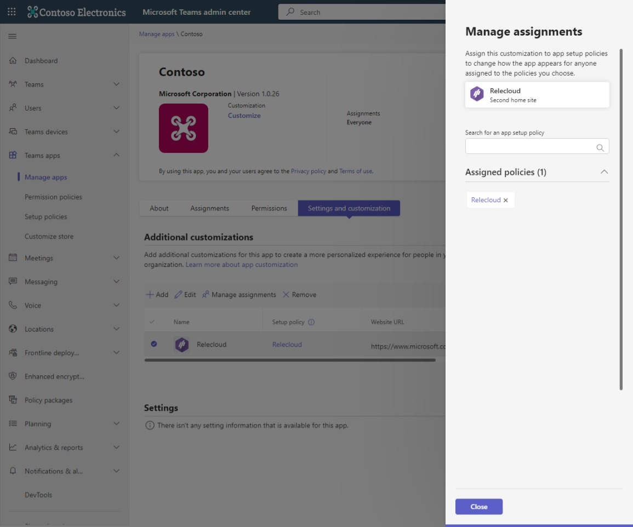
Multi-app customization and policy application
1.
Create new ‘virtual’ app customizations
Enables unique app metadata
2.
Assign unique app name, icons
3.
Assign setup policy
Policy should be assigned to group matching underlying instance

Slide 14
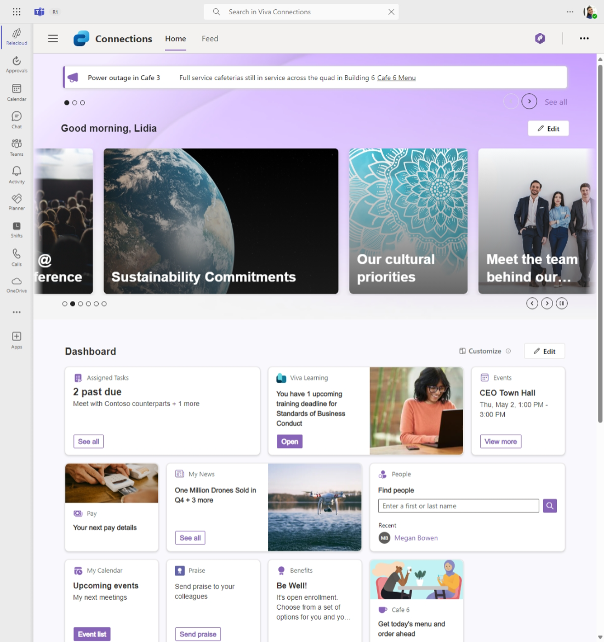
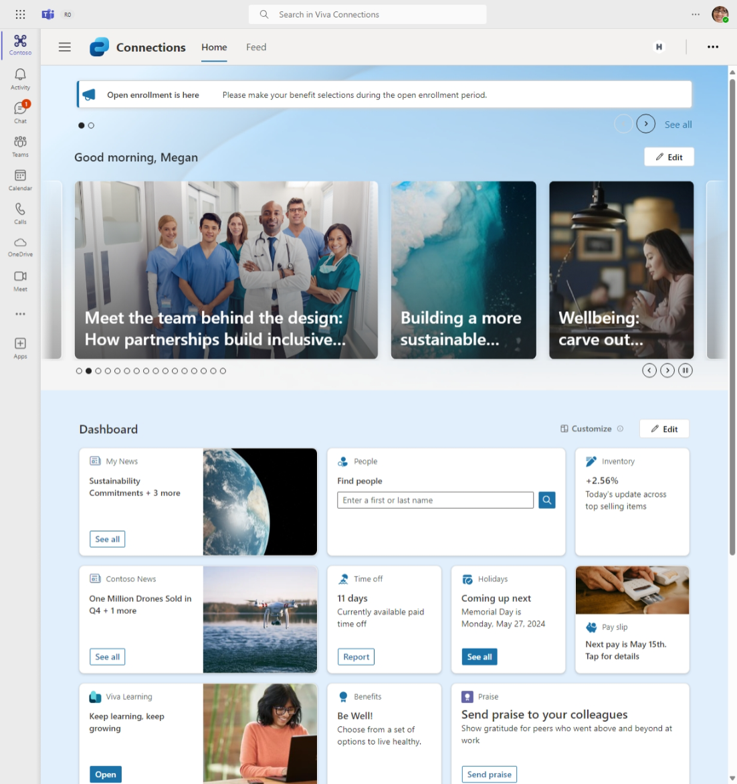
Unique Connections experiences in Teams app bar
Notes:
You can notice in the upper left-hand corner of your Teams app bar, that you can include a clickable logo related to your organization to direct you to the Connections dashboard.

Slide 15
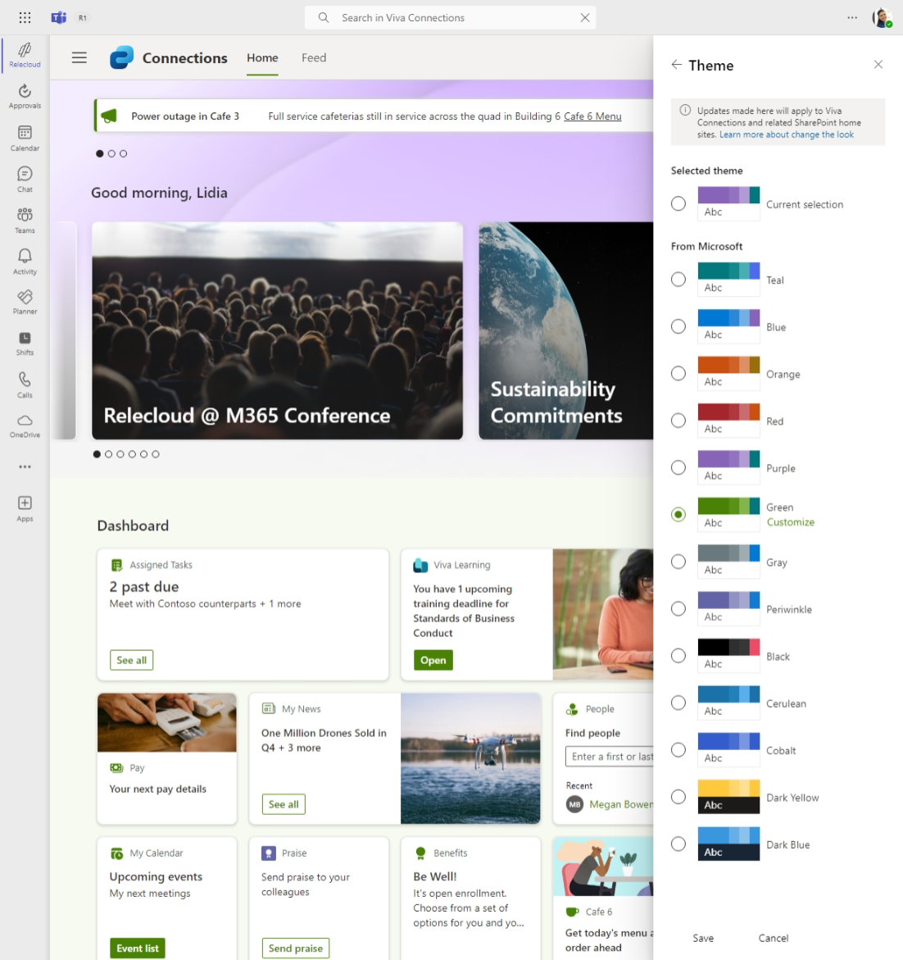
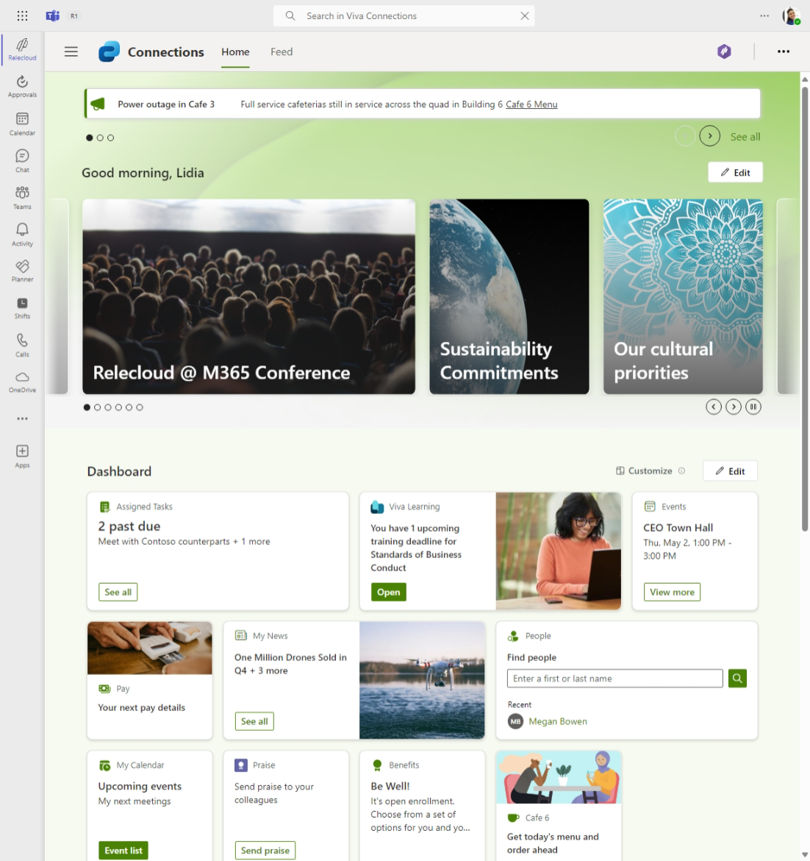
Themes – change the look
Notes:
You can change the look of your Viva Connections dashboard by selecting Theme. After selecting, you can notice the theme colors rendered within your dashboard user interface.

Slide 16
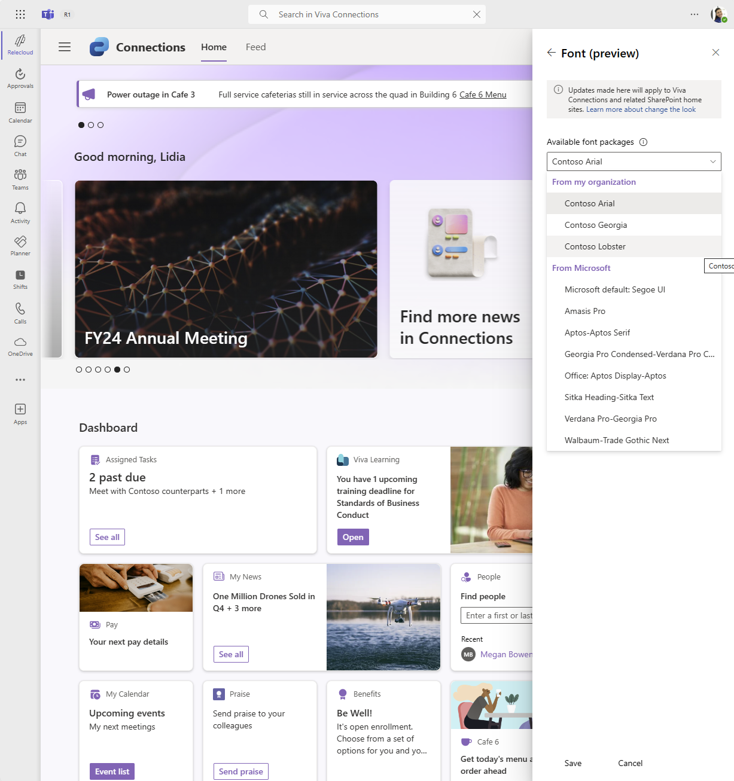
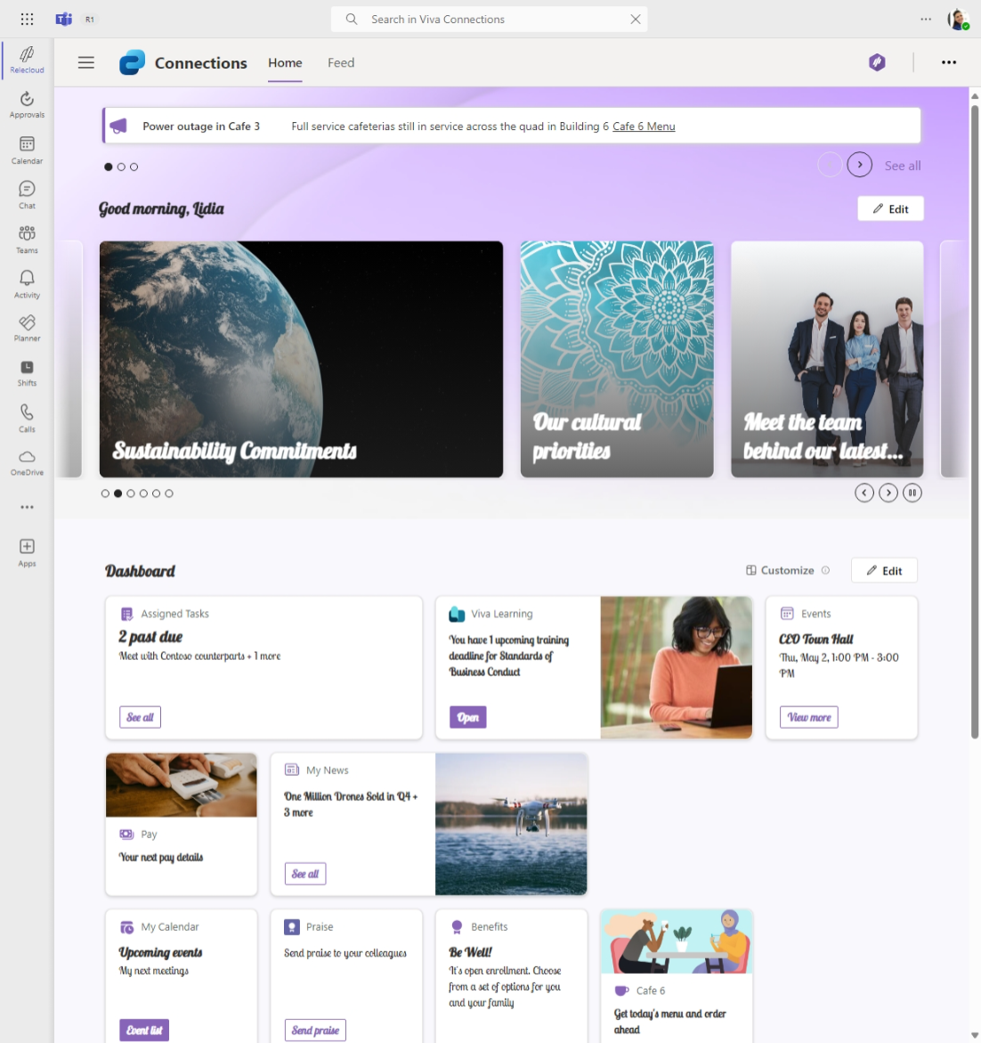
Custom fonts
Notes:
You can change the fonts of your Viva Connections dashboard by selecting Font and selecting from Available font packages. After selecting, you can notice the font rendered within your dashboard user interface.

Slide 17
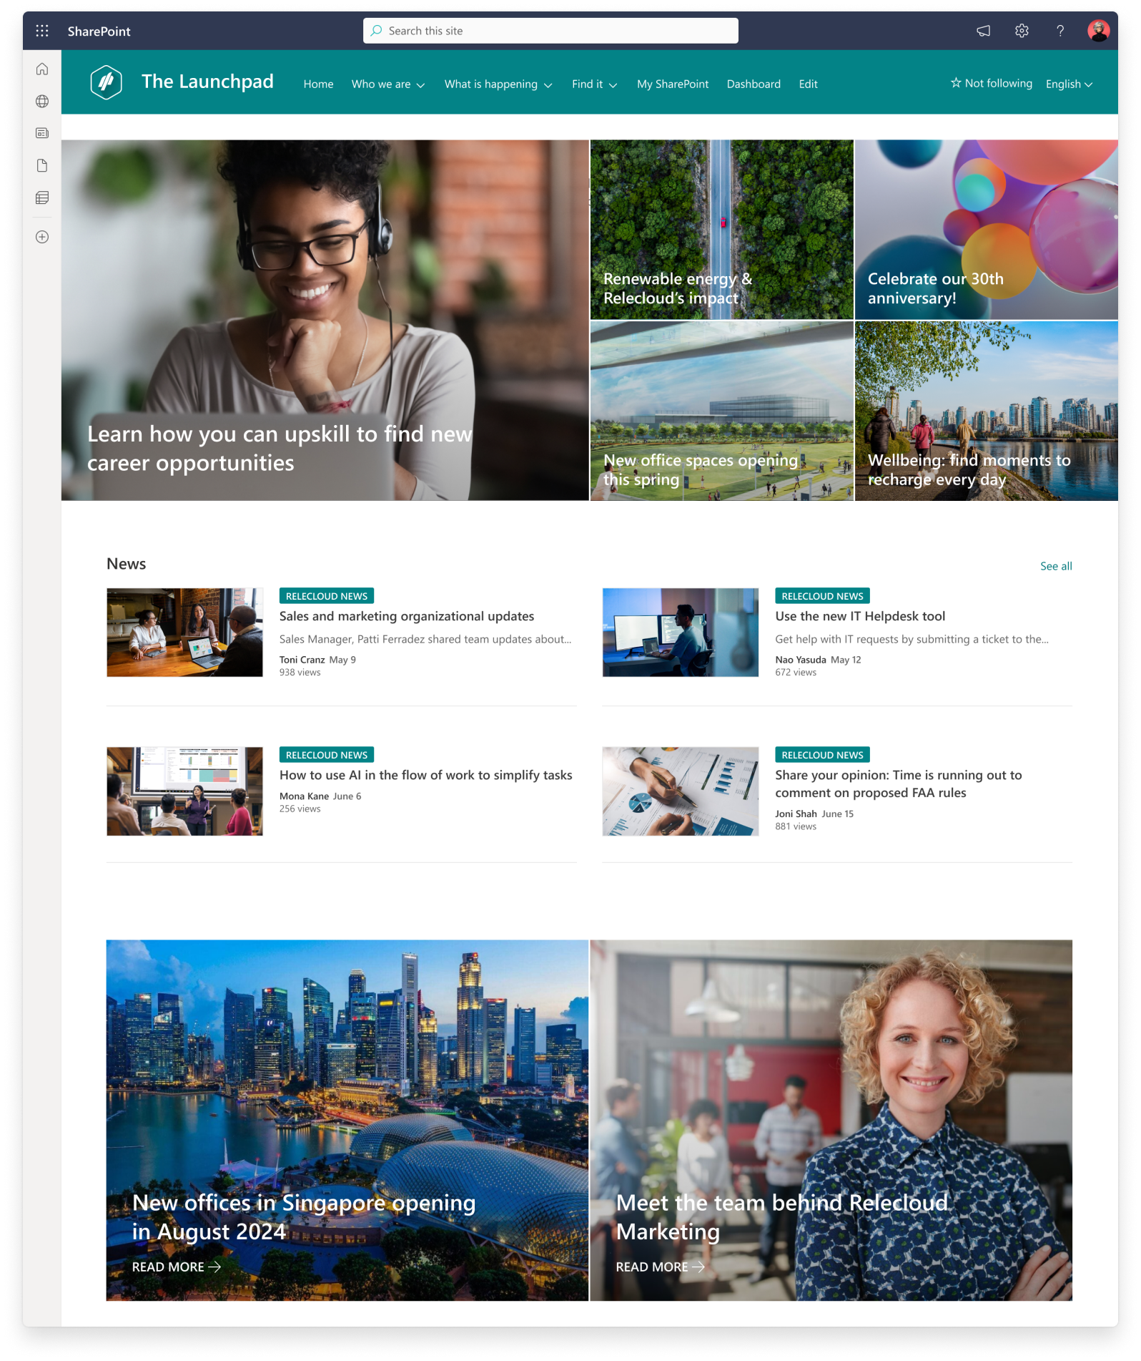
Branded connections across all experiences
Notes:
You can create branded connections across all your Viva Connections dashboard experiences – including mobile, tablet, and desktop.

Slide 18
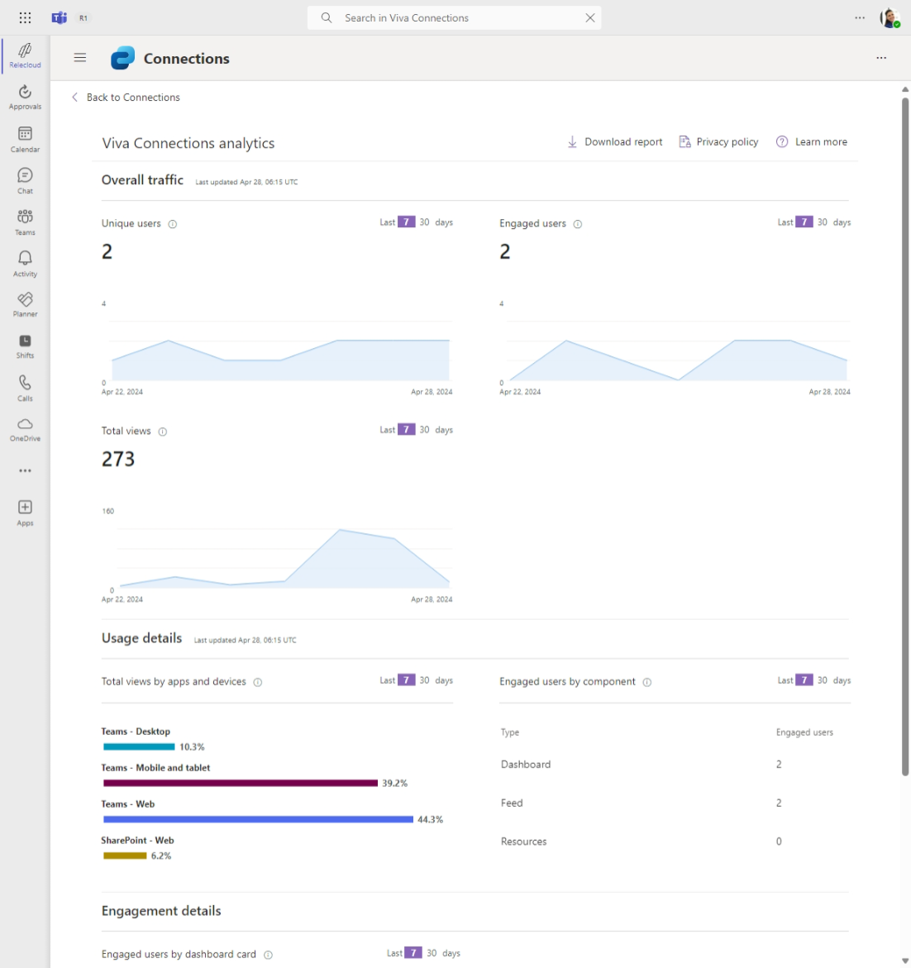
Advanced analytics
Overall traffic
Unique users
Engaged users
Total visits
Usage details
Views by apps & devices
Engaged users by component (dashboard, feed, resources)
Engagement details
Engaged users by dashboard card
Filter & download reports
7 or 30 day filtering
Download Excel report
Notes:
Leverage advanced analytics to track overall traffic, usage details, engagement details, and downloadable reports.

Slide 19
Resources

Slide 20
Learn more
Start using Viva Connections: Overview: Viva Connections
Design guidelines: Dashboard cards design guidance
Stay updated with new features: Viva Connections Blog on the Microsoft Community Hub
Dashboard card creation: Add, edit, and remove cards from the Viva Connections dashboard
Branding theming: New UX and branding settings now available for the Viva Connections
Setup / admin resources: Overview: Viva Connections
Microsoft Viva Adoption Hub

Slide 21
Microsoft Viva

